Slide 1


智冠科技 數位發展中心
Google Cloud Platform Tutorial
智冠科技

Slide 2
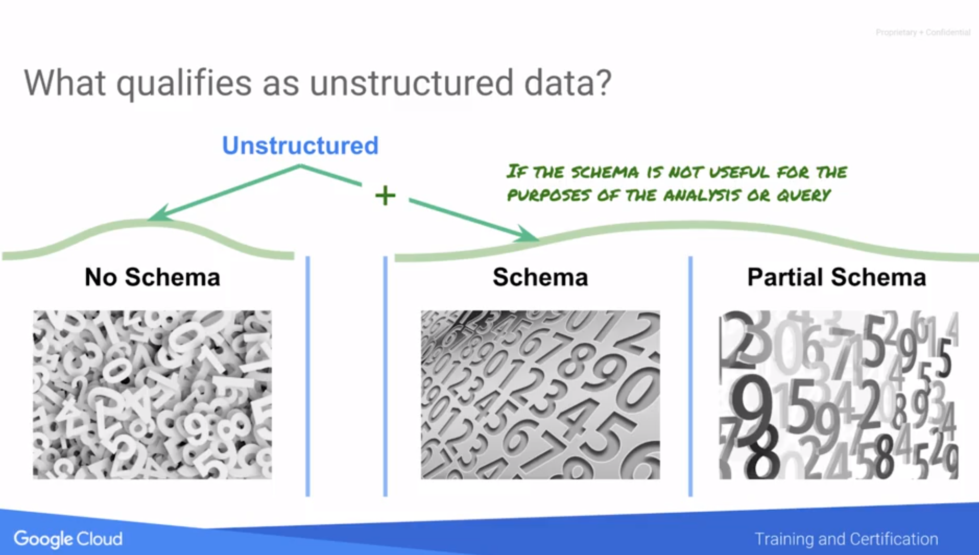
Unstructured Data is a relative term to the relational data base which has strict schema. In the real word, majority of the data is unstructured
Since structured data will fit one purpose but become unstructured data for another purpose.

Slide 3
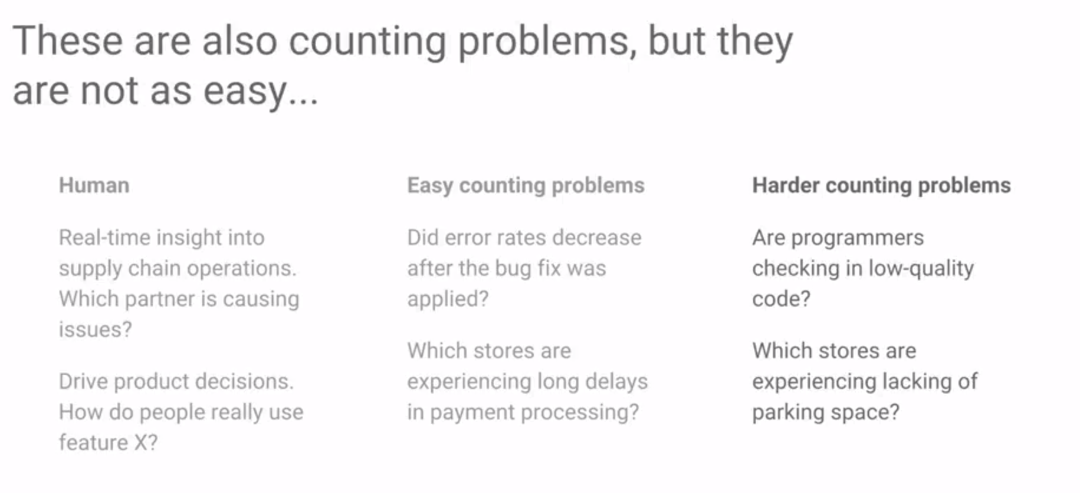
How to predict something which is not even there Curiosity and working with absence are not yet great application for automation
Eliminate hard problems require human intervention Unsupervised
ML, Segmentation

Slide 4
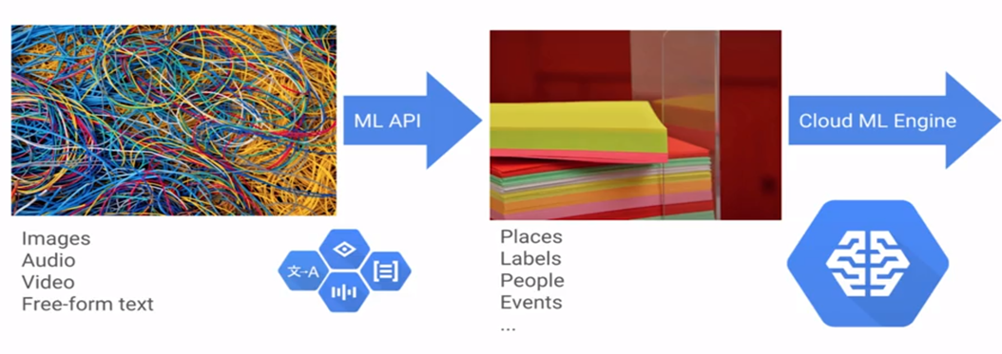
Build ML model on top of google
Deriving Value from unstructured data
Managed Server, PC, Data, Server, Software, Electronic, Power
Controll everything, all counts on you

Slide 5

Unstructured Data is a relative term to the relational data base which has strict schema. In the real word, majority of the data is unstructured
Since structured data will fit one purpose but become unstructured data for another purpose.

Slide 6
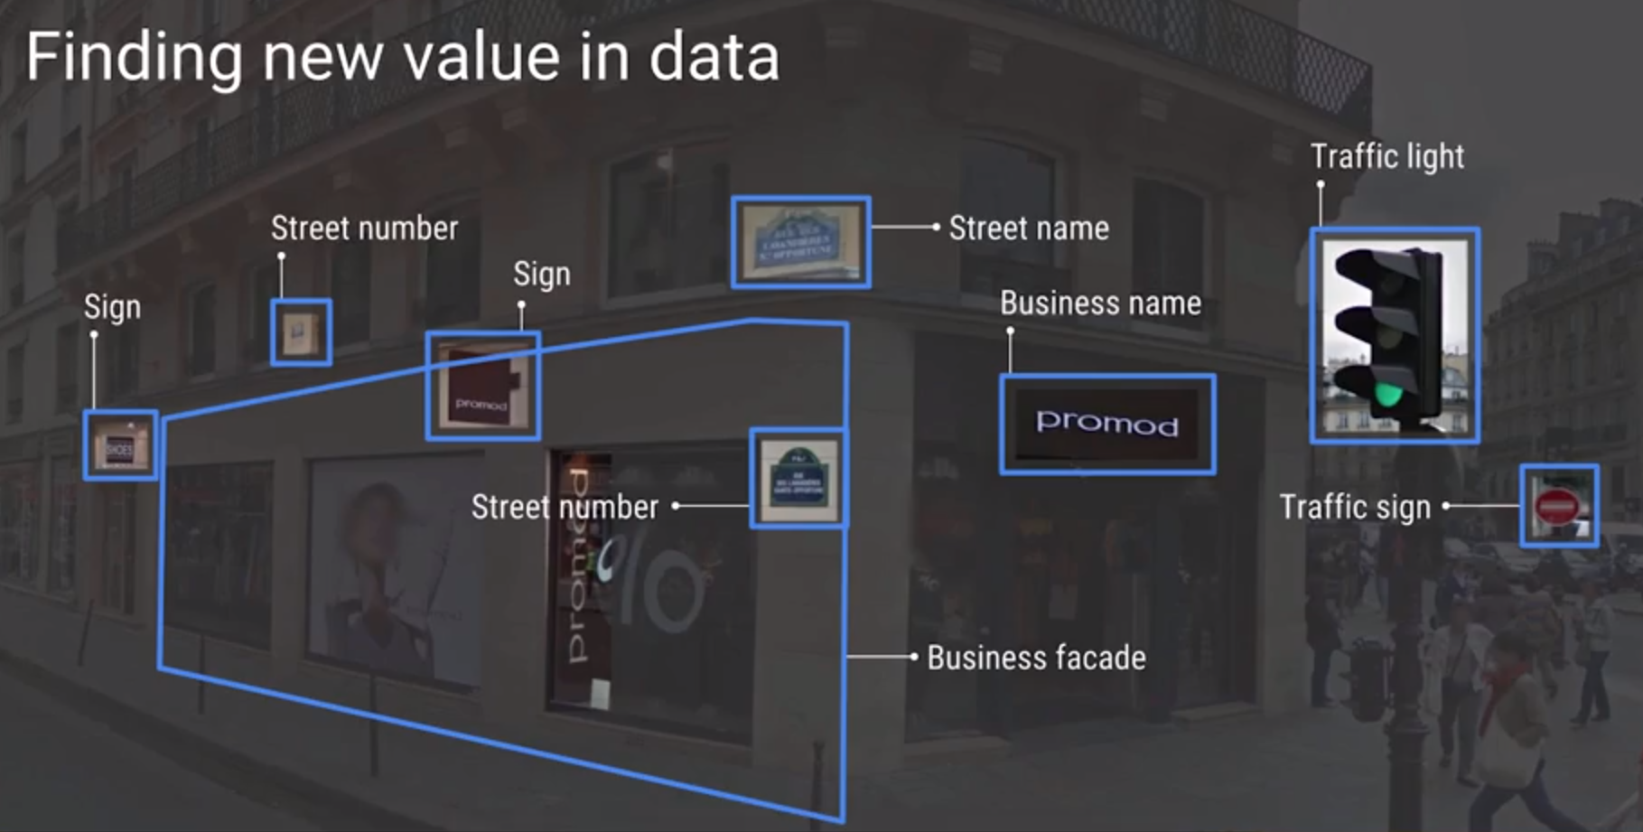

Slide 7

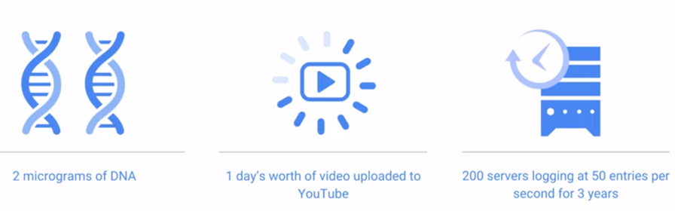
Cloud Dataproc Cloud based implementation of Hadoop
Cloud Dataproc
Gigabyte, Terabyte
Why run hadoop on a cloud platform? Cheap Storage for Petabyte
Using share resource makes sense when in comes to Petabyte

Slide 8

Cloud Dataproc How to deal with large amount of data
Cloud Dataproc
Adding lots of big computers or server
Why run hadoop on a cloud platform? Cheap Storage for Petabyte
Using share resource makes sense when in comes to Petabyte
Increase distributed parallel processing abilities
Vertical Scaling： Cost ↑ Value ↓
Horizontal Scaling： scalable solution, require programming abilities

Slide 9
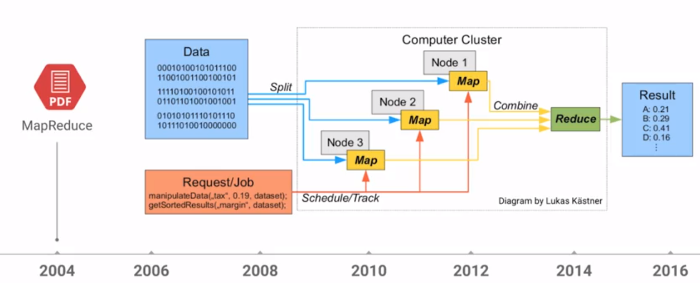
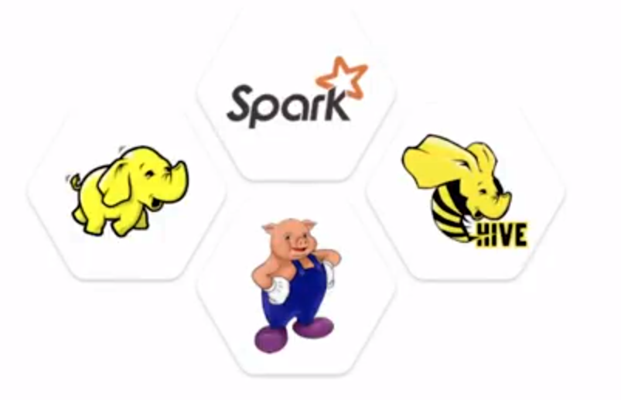
Cloud Dataproc limitation leads to innovations
MapReduce and Hadoop origins
Limitation of RDB leads to no SQL solutions
Hadoop require investing clusters and lots of powerful computers

Slide 10
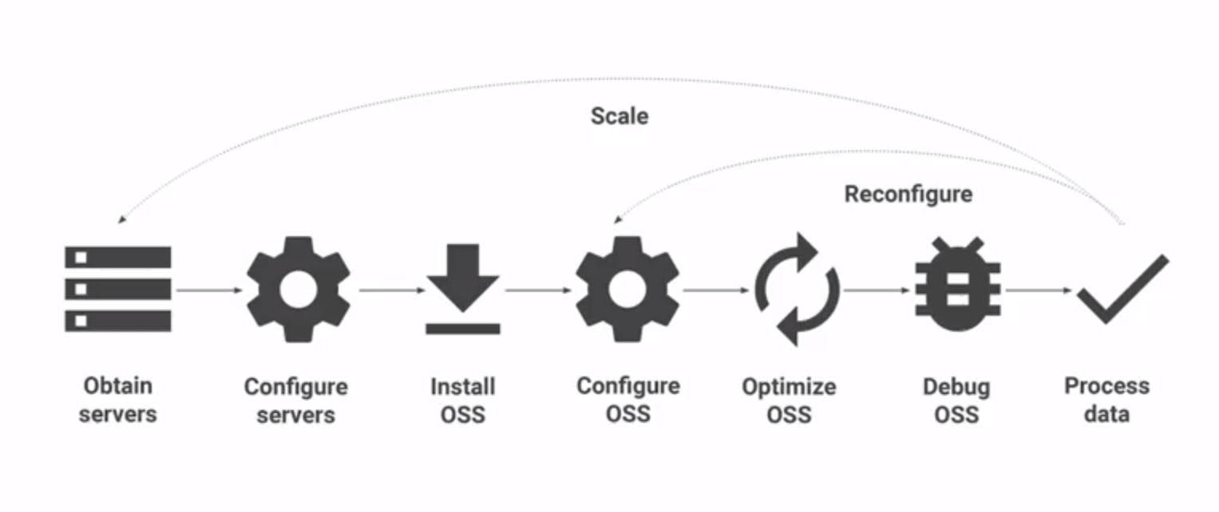
Cloud Dataproc Typical Spark and hadoop deployments
MapReduce and Hadoop origins
Lots of setting and programming waiting to be done
demand change
business require change
Open Source Software

Slide 11
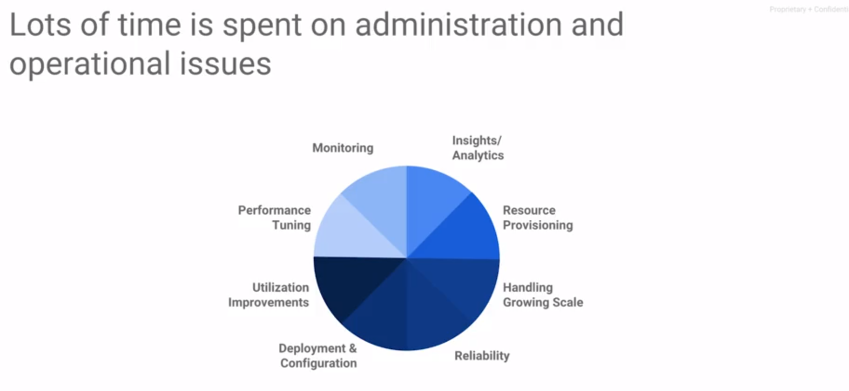
Cloud Dataproc Typical Spark and hadoop deployments
MapReduce and Hadoop origins

Slide 12
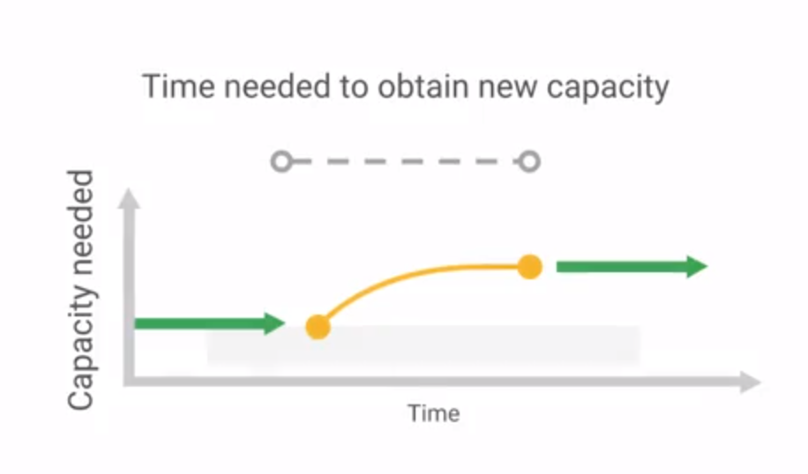
Cloud Dataproc Time wasting on administration setting
MapReduce and Hadoop origins
Rebalance the distribution to the data, load-balance
Resharding, moving, copying. takes days or weeks moving data around without creating business value

Slide 13
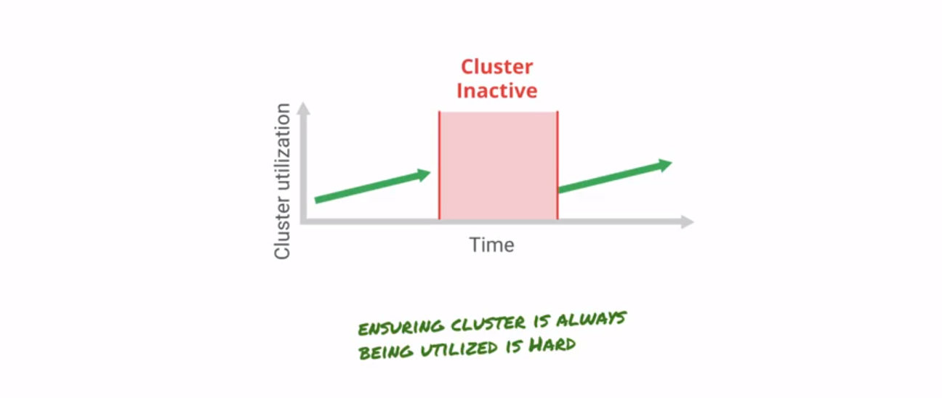
Cloud Dataproc Time wasting on administration setting
MapReduce and Hadoop origins
Low utilization Clusters will become costly storage Reluctantly to find other business issues to increase the cluster usage, won’t end up well

Slide 14
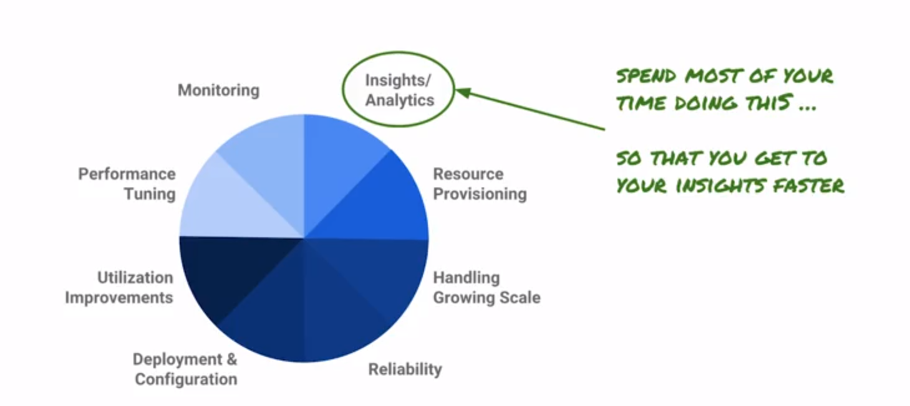
Cloud Dataproc Focus on insights/Analytics
MapReduce and Hadoop origins

Slide 15
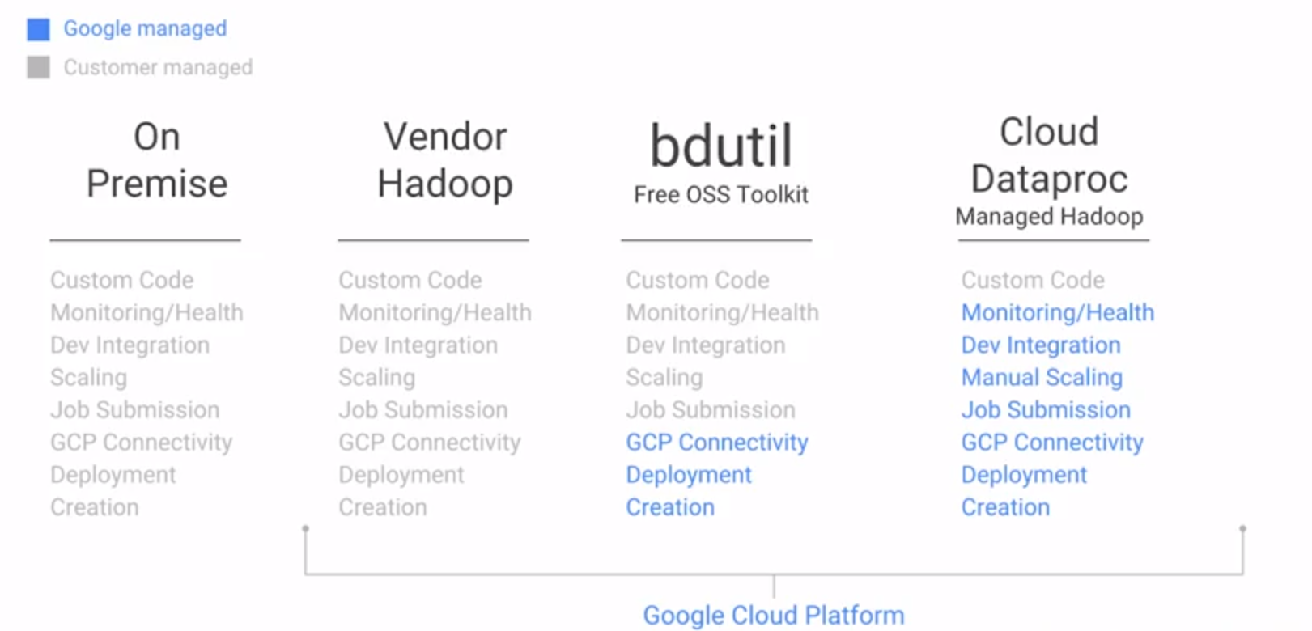
Cloud Dataproc Dataproc eases hadoop management
MapReduce and Hadoop origins
Your code is still handled by yourself

Slide 16
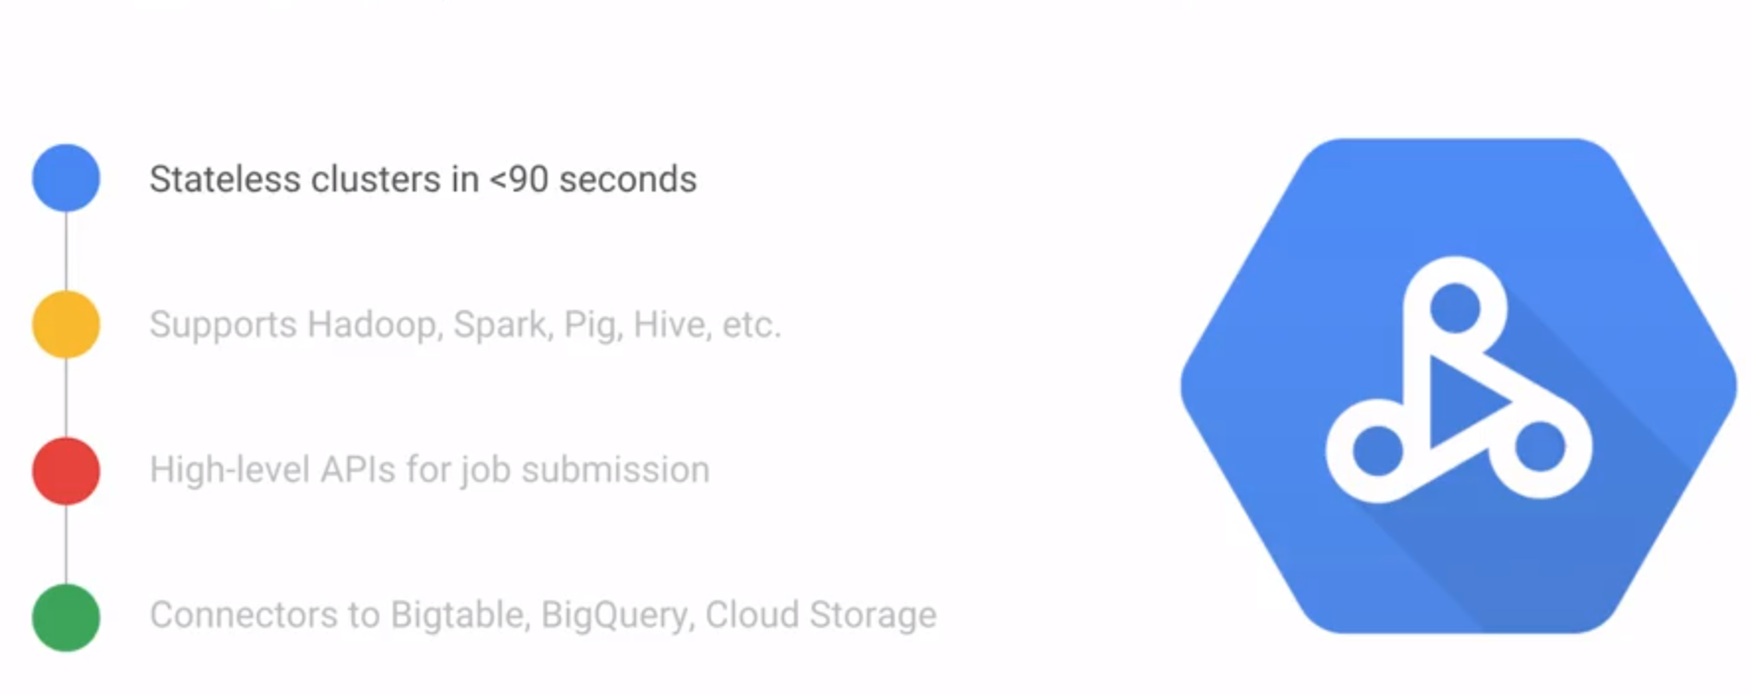
Cloud Dataproc Dataproc eases hadoop management
MapReduce and Hadoop origins
Building Cluster < 90s
Support Hadoop, Hive, Pig, etc
High Level API for Job submission
Connectors to BigTable, BigQuery, Cloud Storage

Slide 17
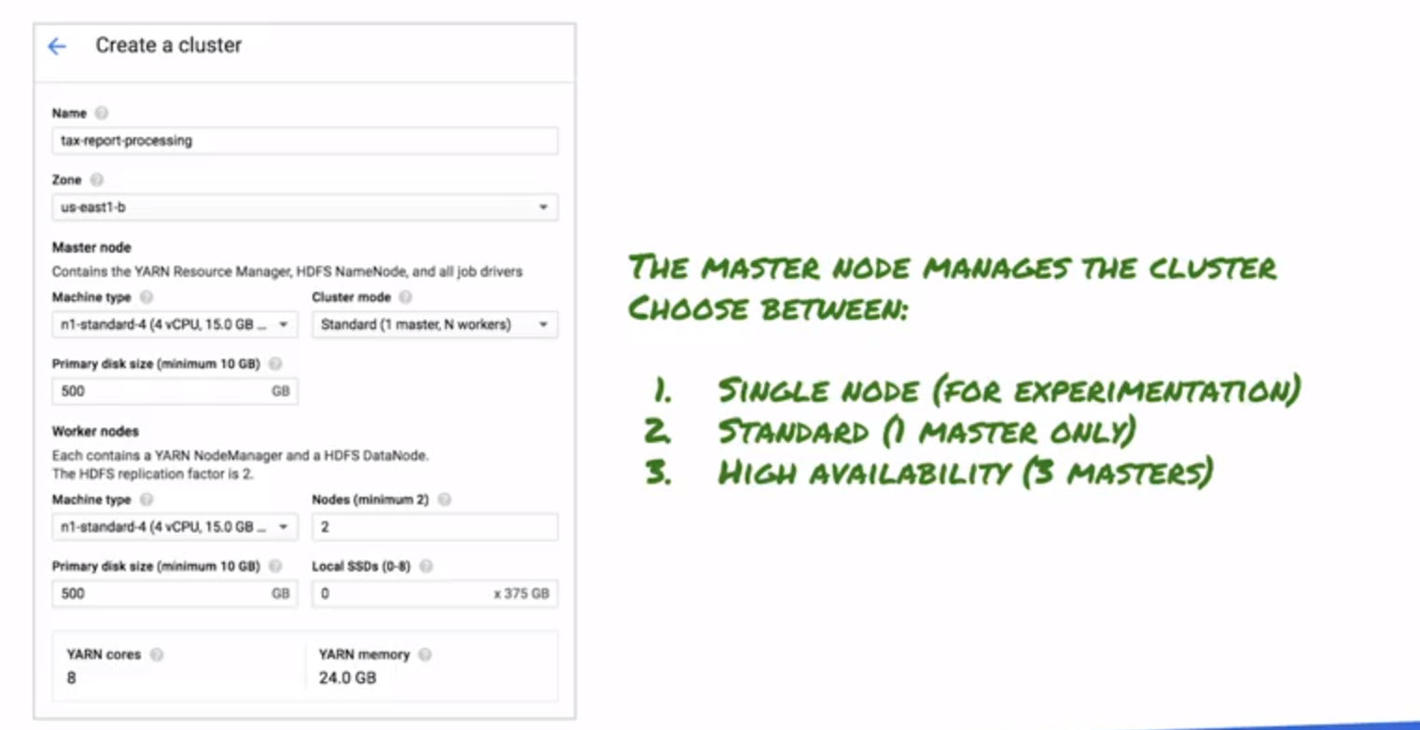
Cloud Dataproc Cluster configurations: Master Node
Creating Dataproc Cluster
Ingress point for job submission
long running job, loss single VM wont loss the job

Slide 18
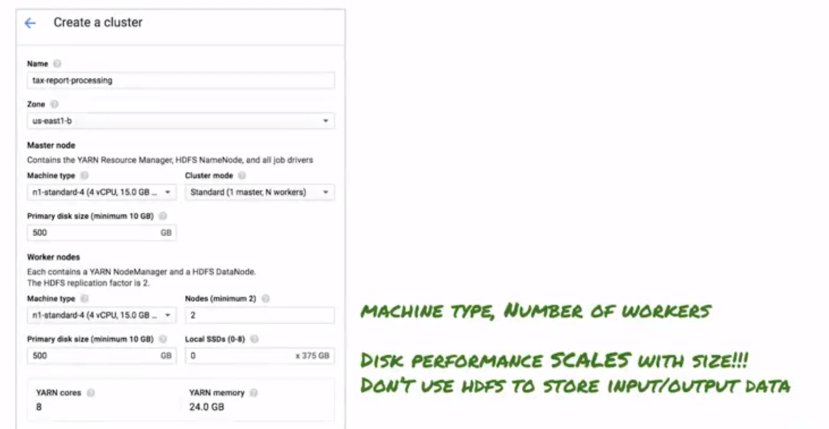

Cloud Dataproc Cluster configurations: HDFS (dont use it)
Creating Dataproc Cluster
HDFS will reduce the change adoption from the existing system,
Cloud Storage can achieve that and it will avoid the complexity of configuring the cluster
HDFS: 500g → 600g → HDFS default*3 (1.8T) backup Cloud Storage：dynamically scale to meet ur requirements, (u don’t need to predict the storage in advance) it will resize the cluster. Cloud Storage makes the cluster stateless (shut it down when not need it)

Slide 19
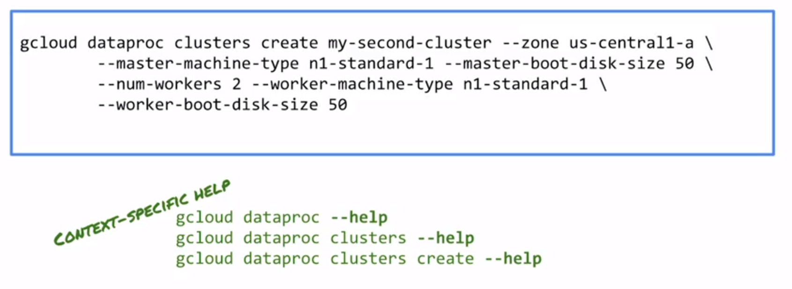
Cloud Dataproc Google Cloud Command
Google Cloud Command

Slide 20
Cloud Dataproc Typical Spark and hadoop deployments
MapReduce and Hadoop origins
Hive: Declarative, specifies exactly how to perform data analysis limits the flexibilities Hive cant decide how to use the resource to get results
Pig: Imperative, make execution plan System will determine how to process data
use for pipeline processing data

Slide 22
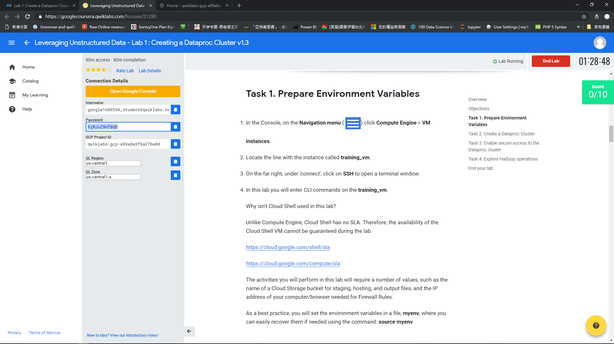

Slide 23
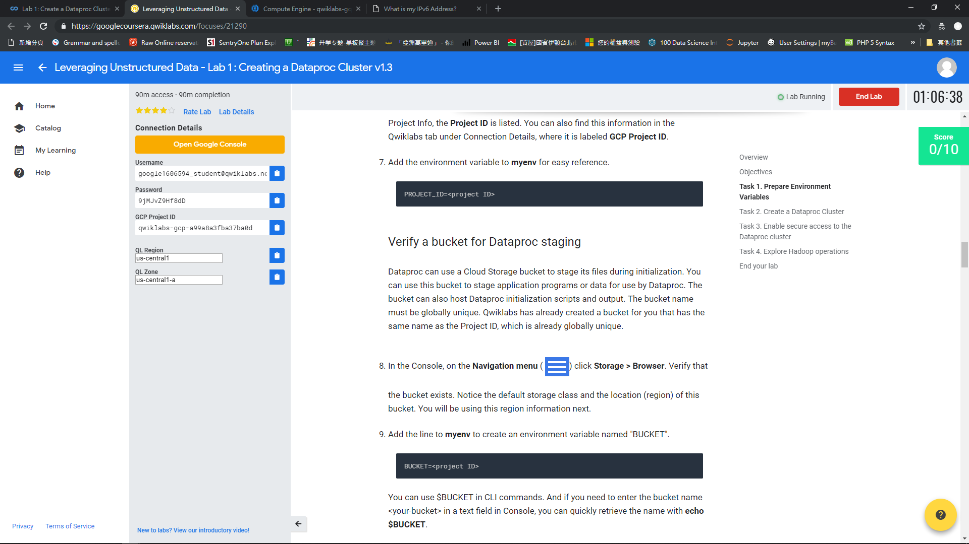

Slide 24
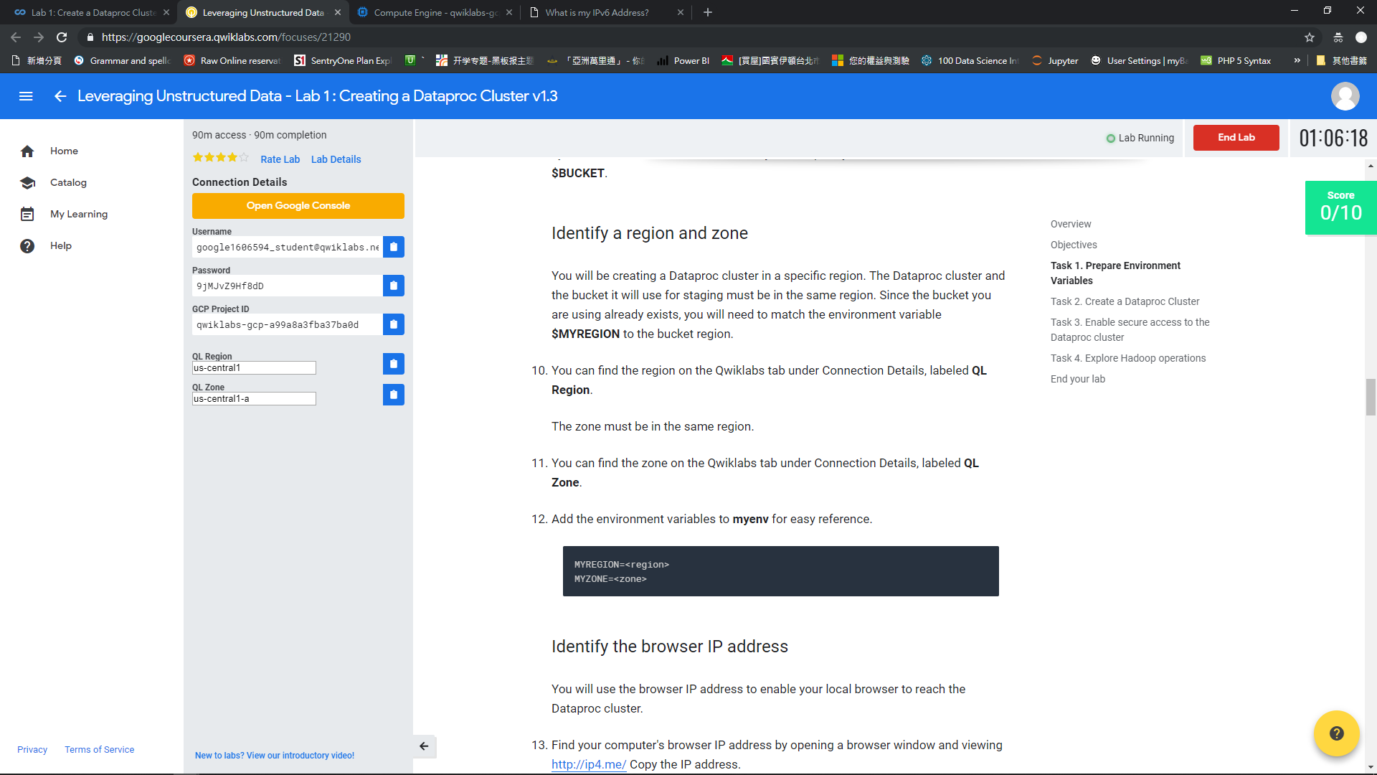

Slide 25
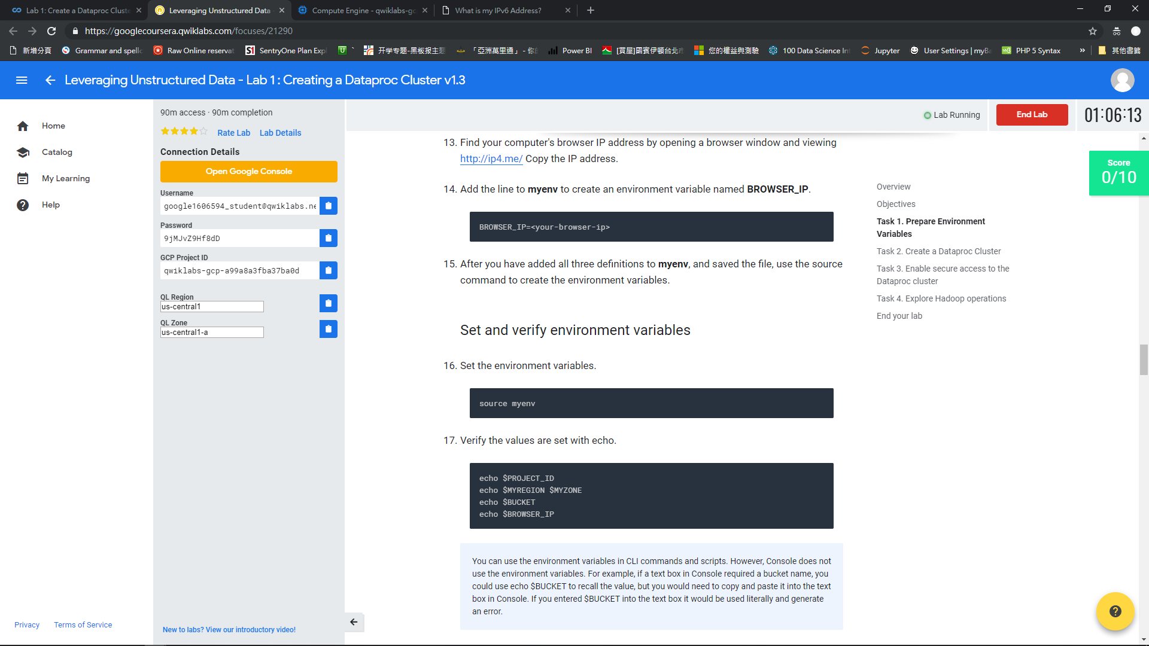

Slide 26
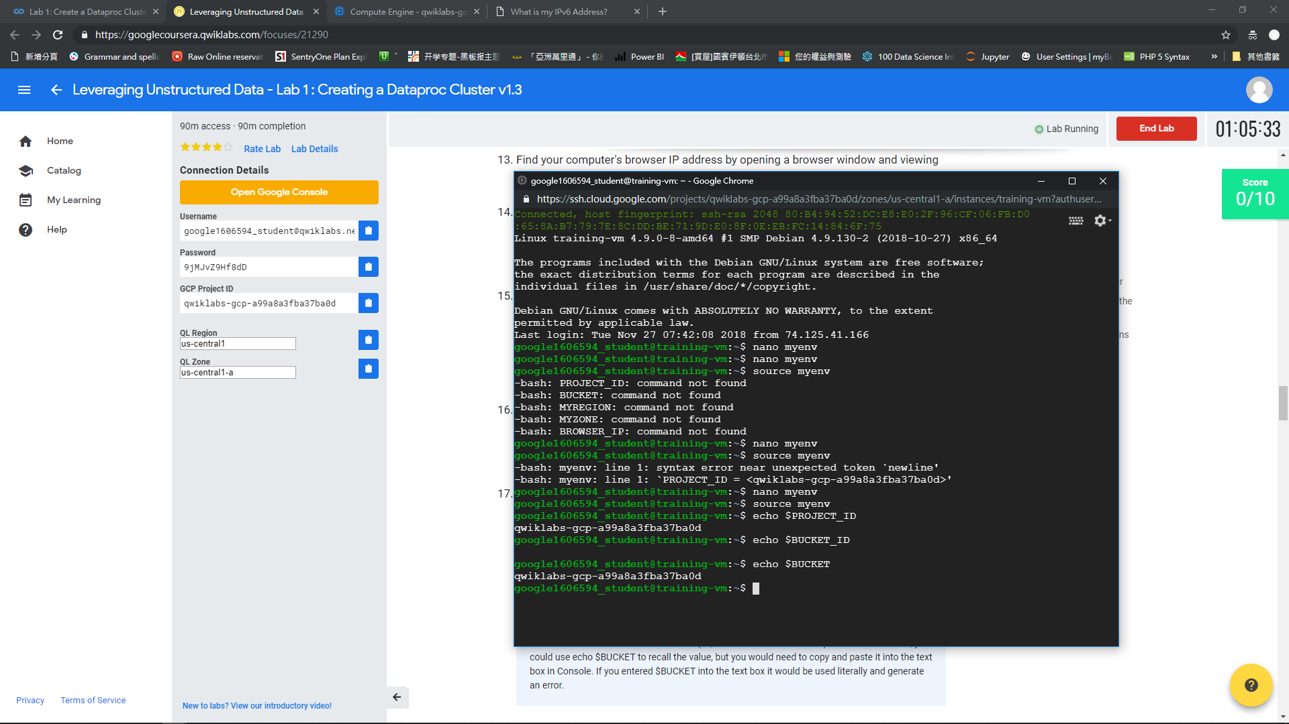

Slide 27
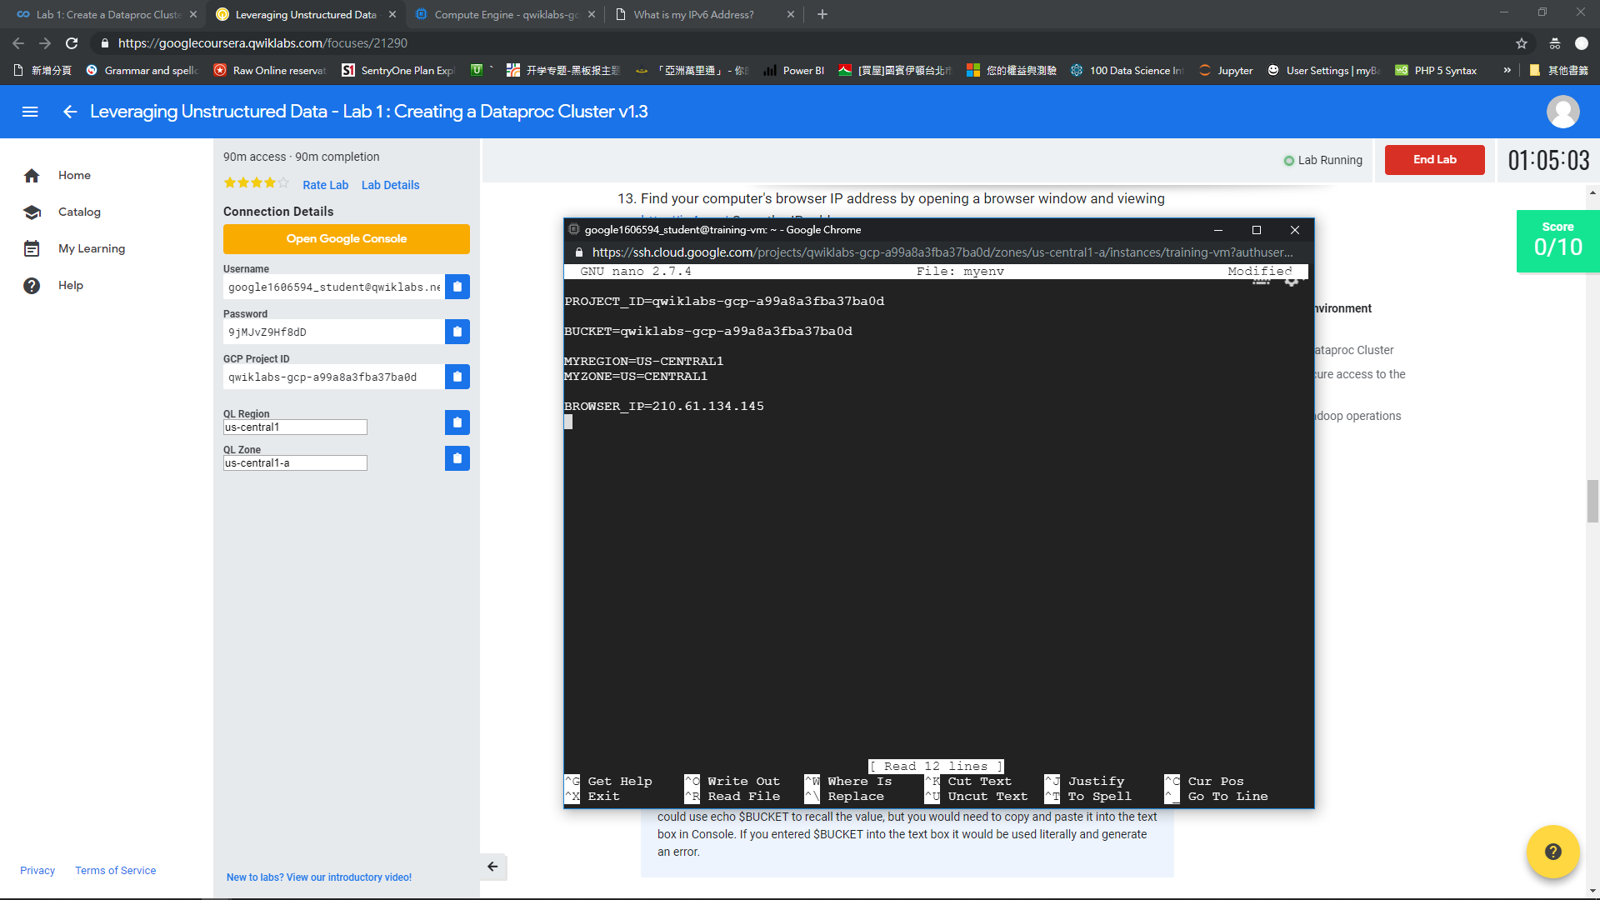

Slide 28
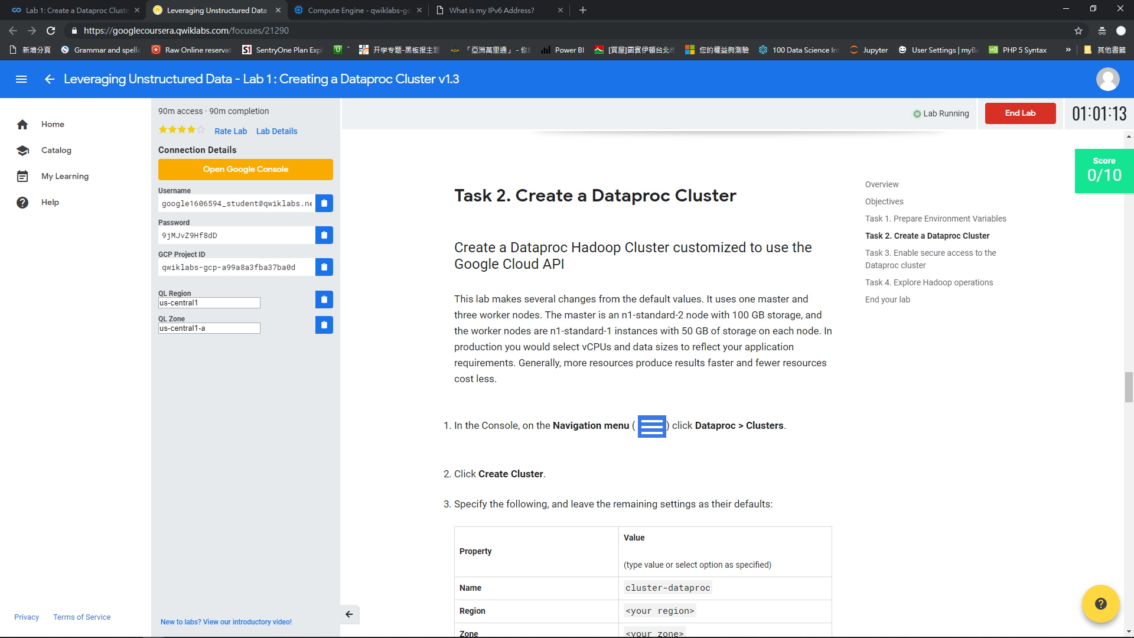

Slide 29
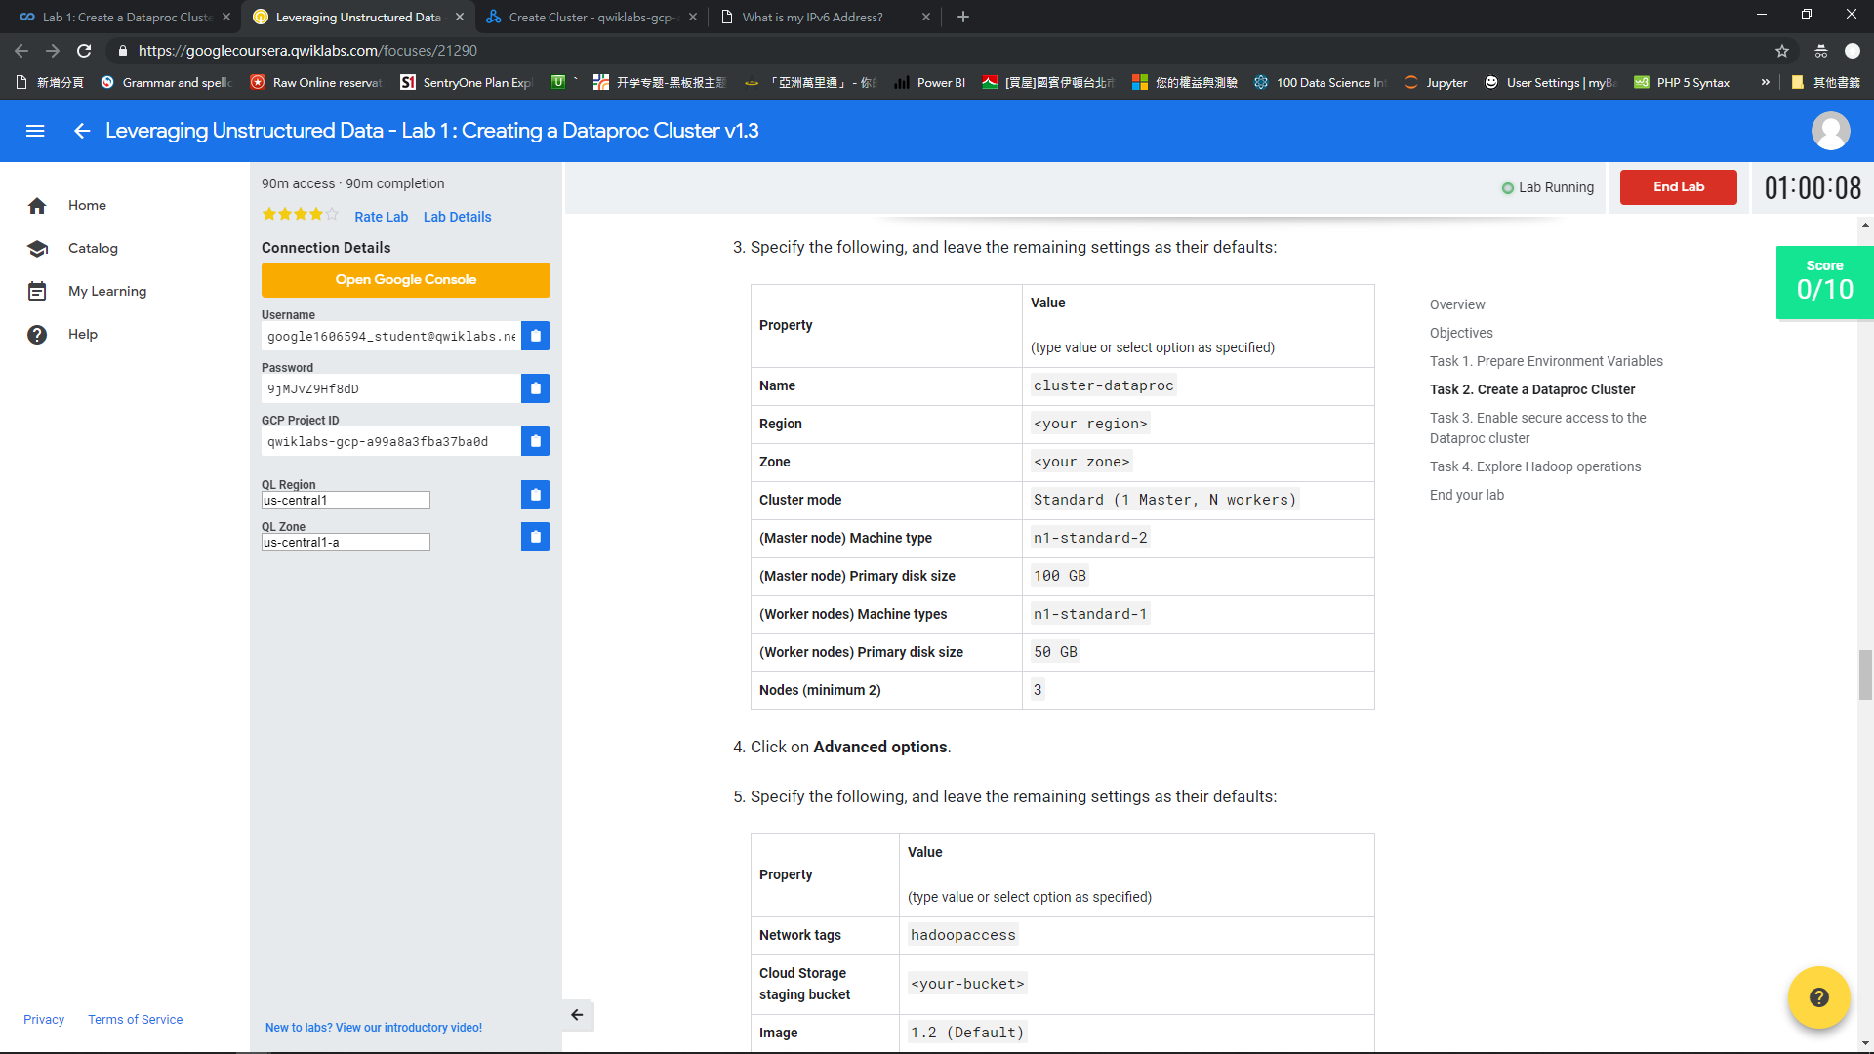

Slide 30
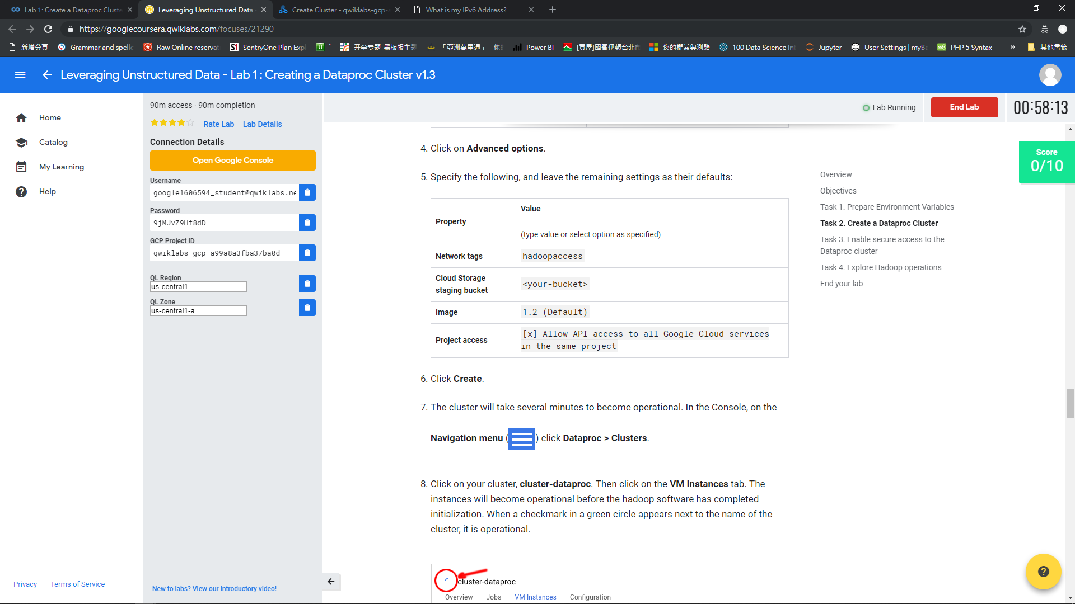

Slide 31
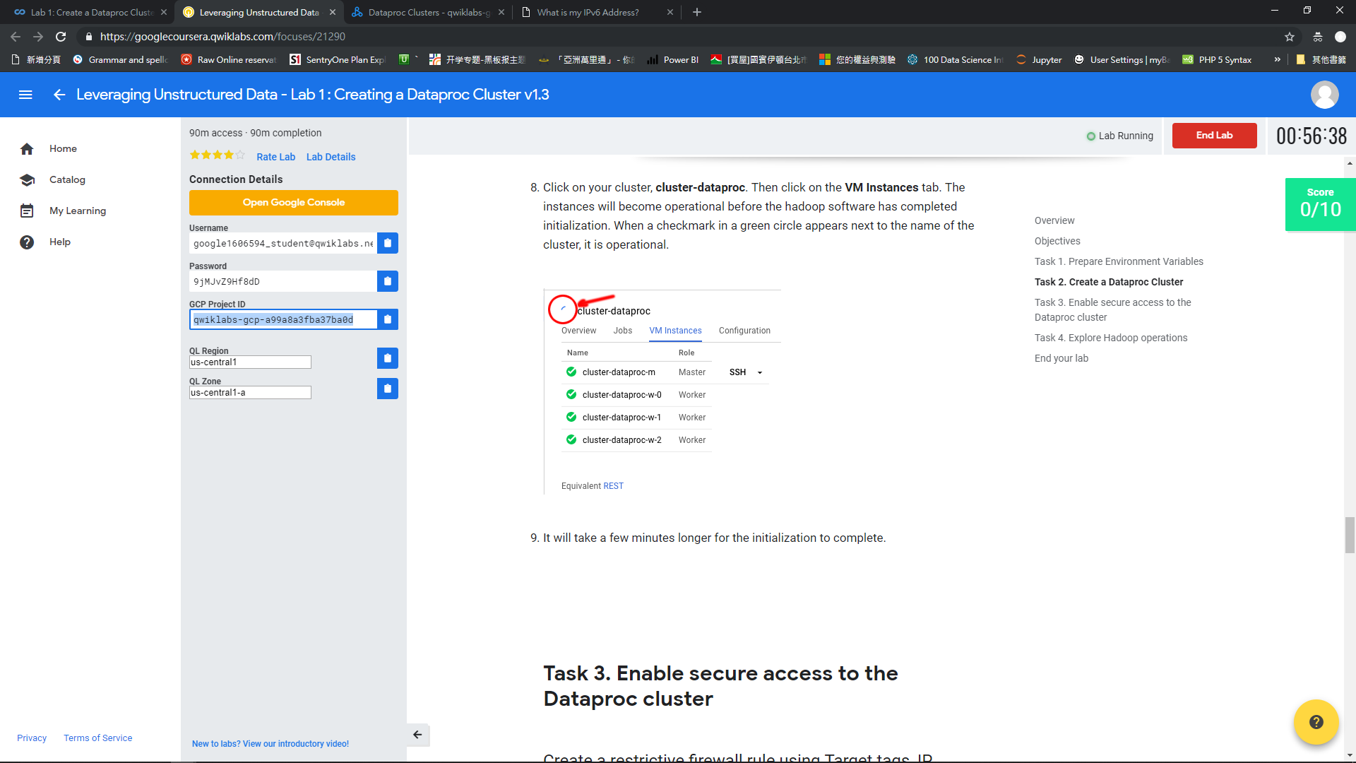

Slide 32
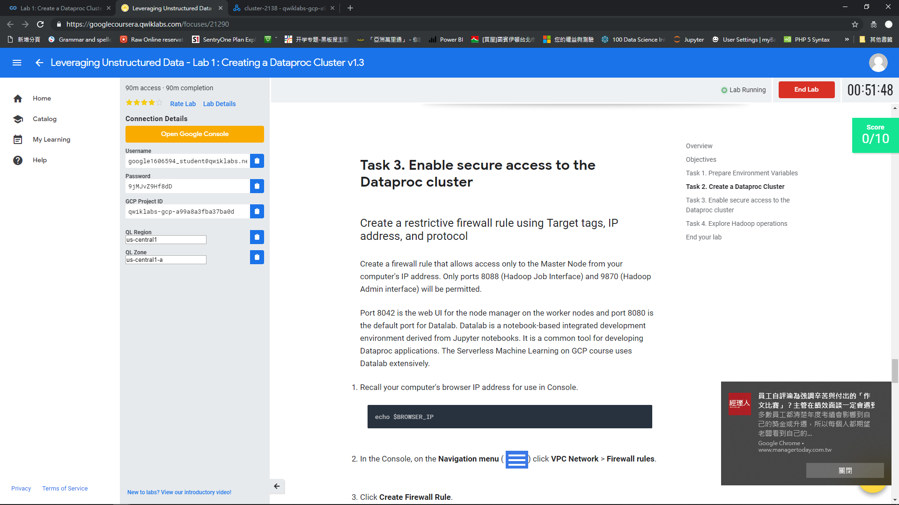

Slide 33
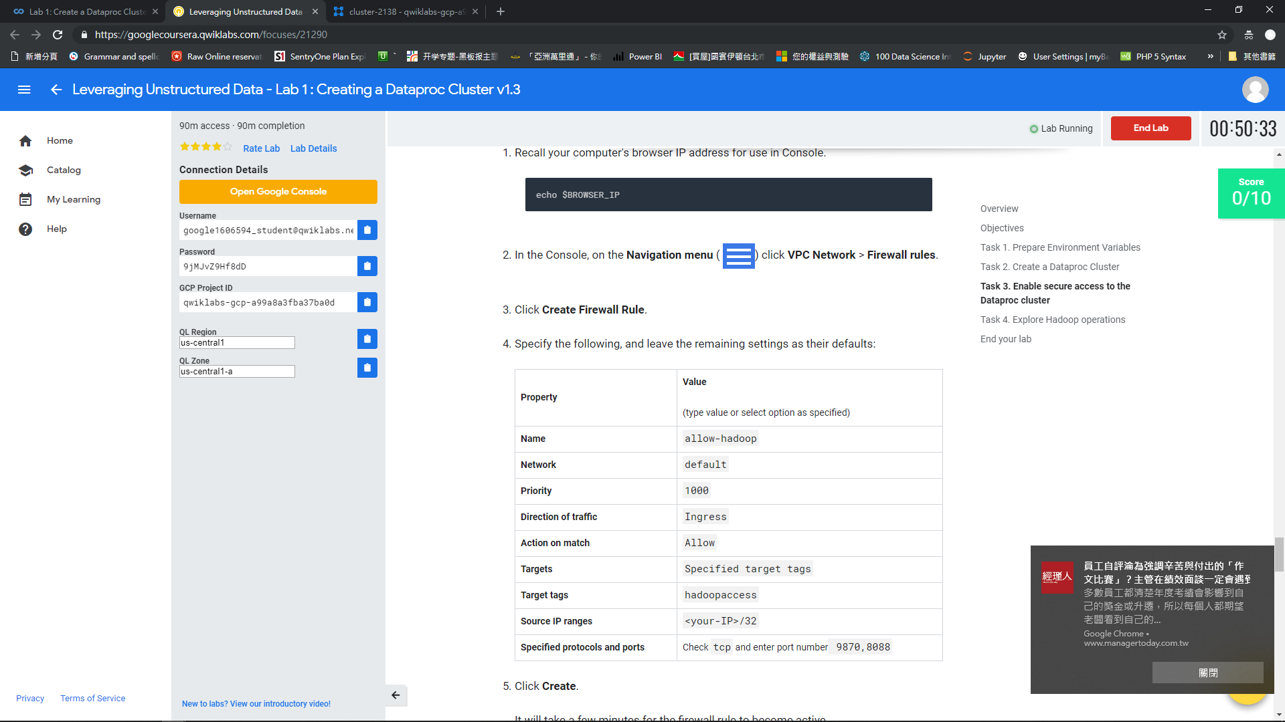

Slide 34
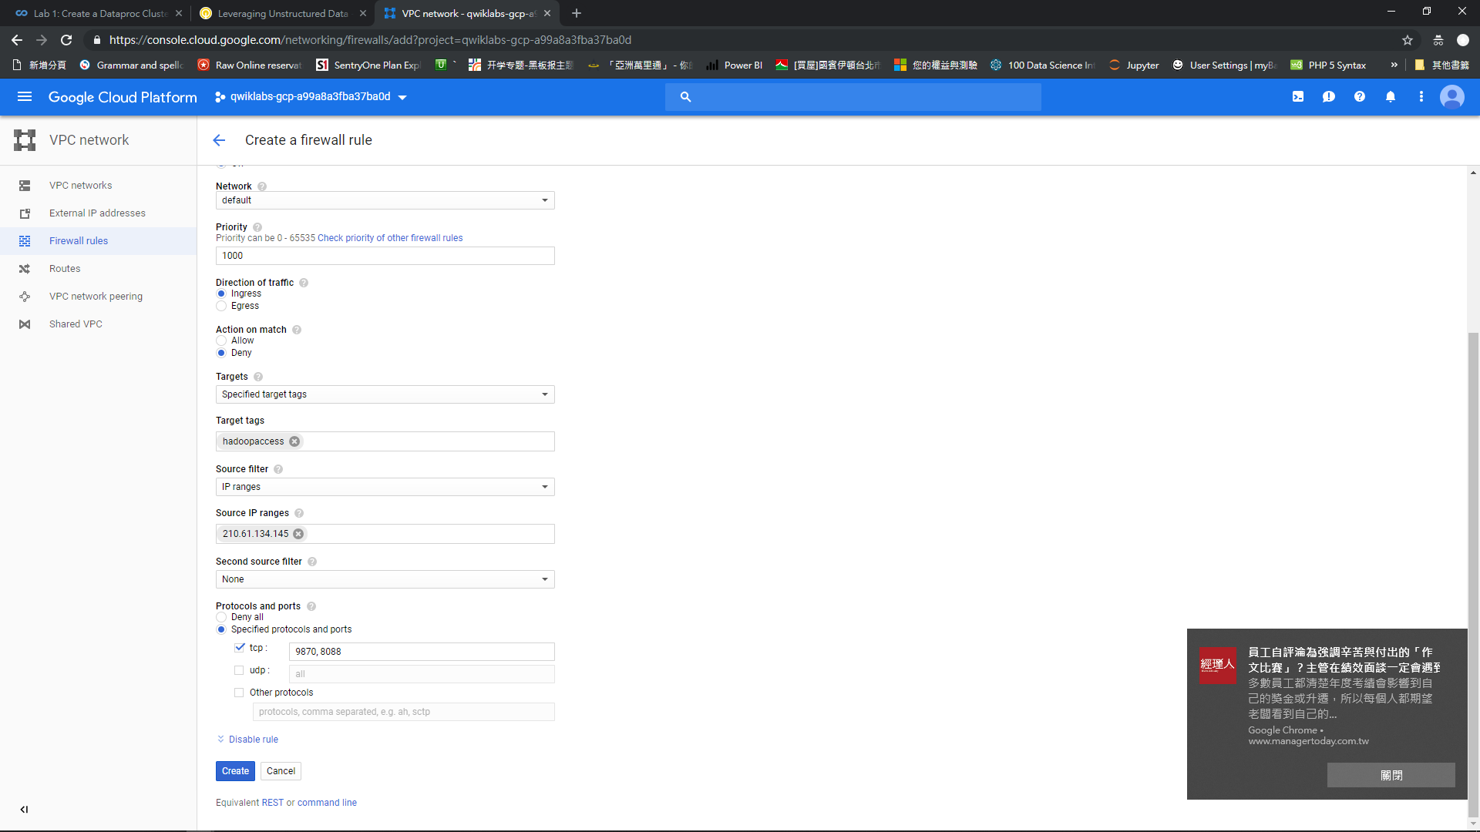

Slide 35
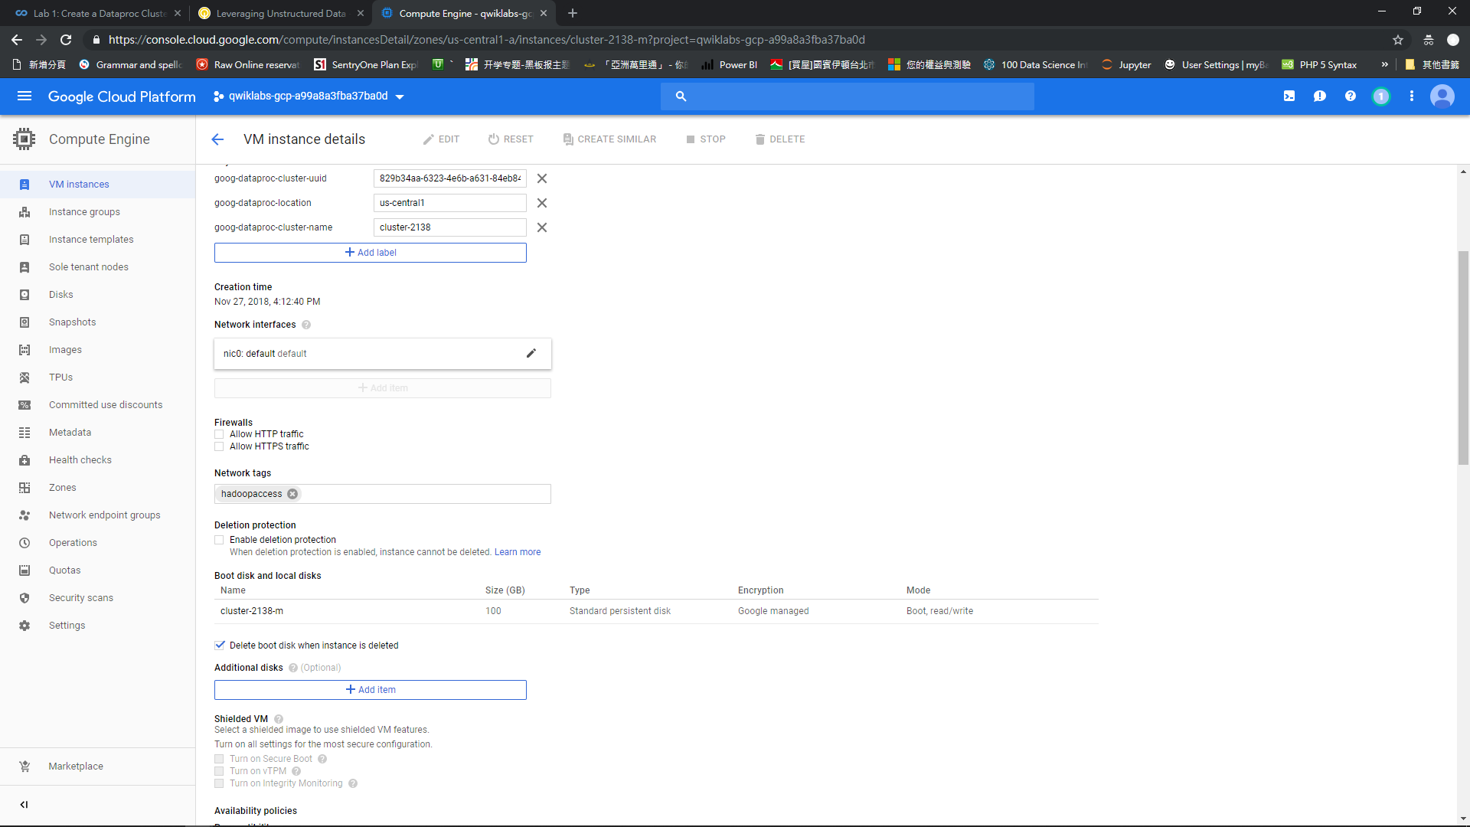

Slide 36
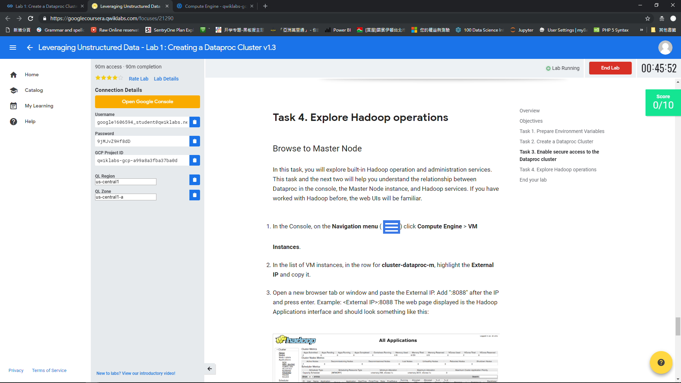

Slide 39
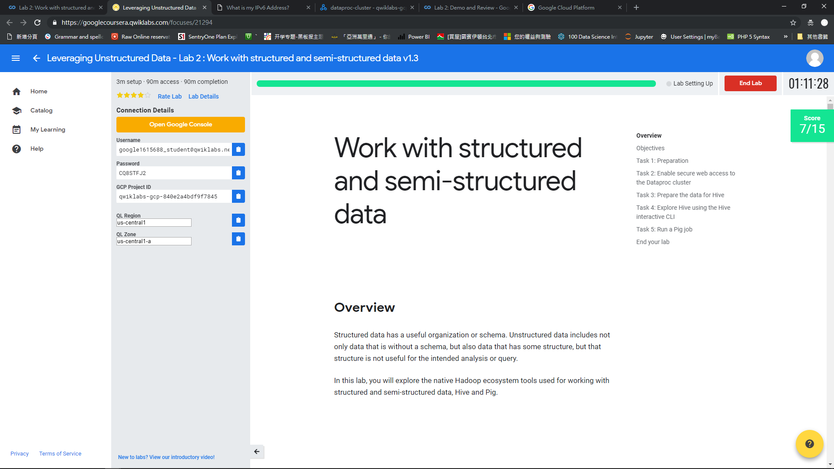

Slide 40
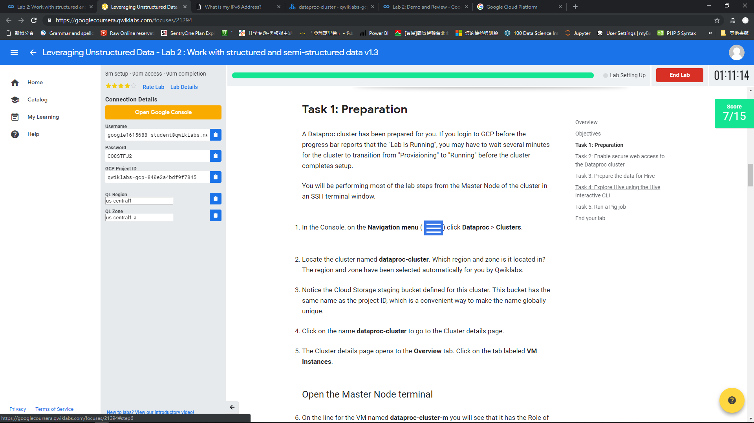

Slide 41
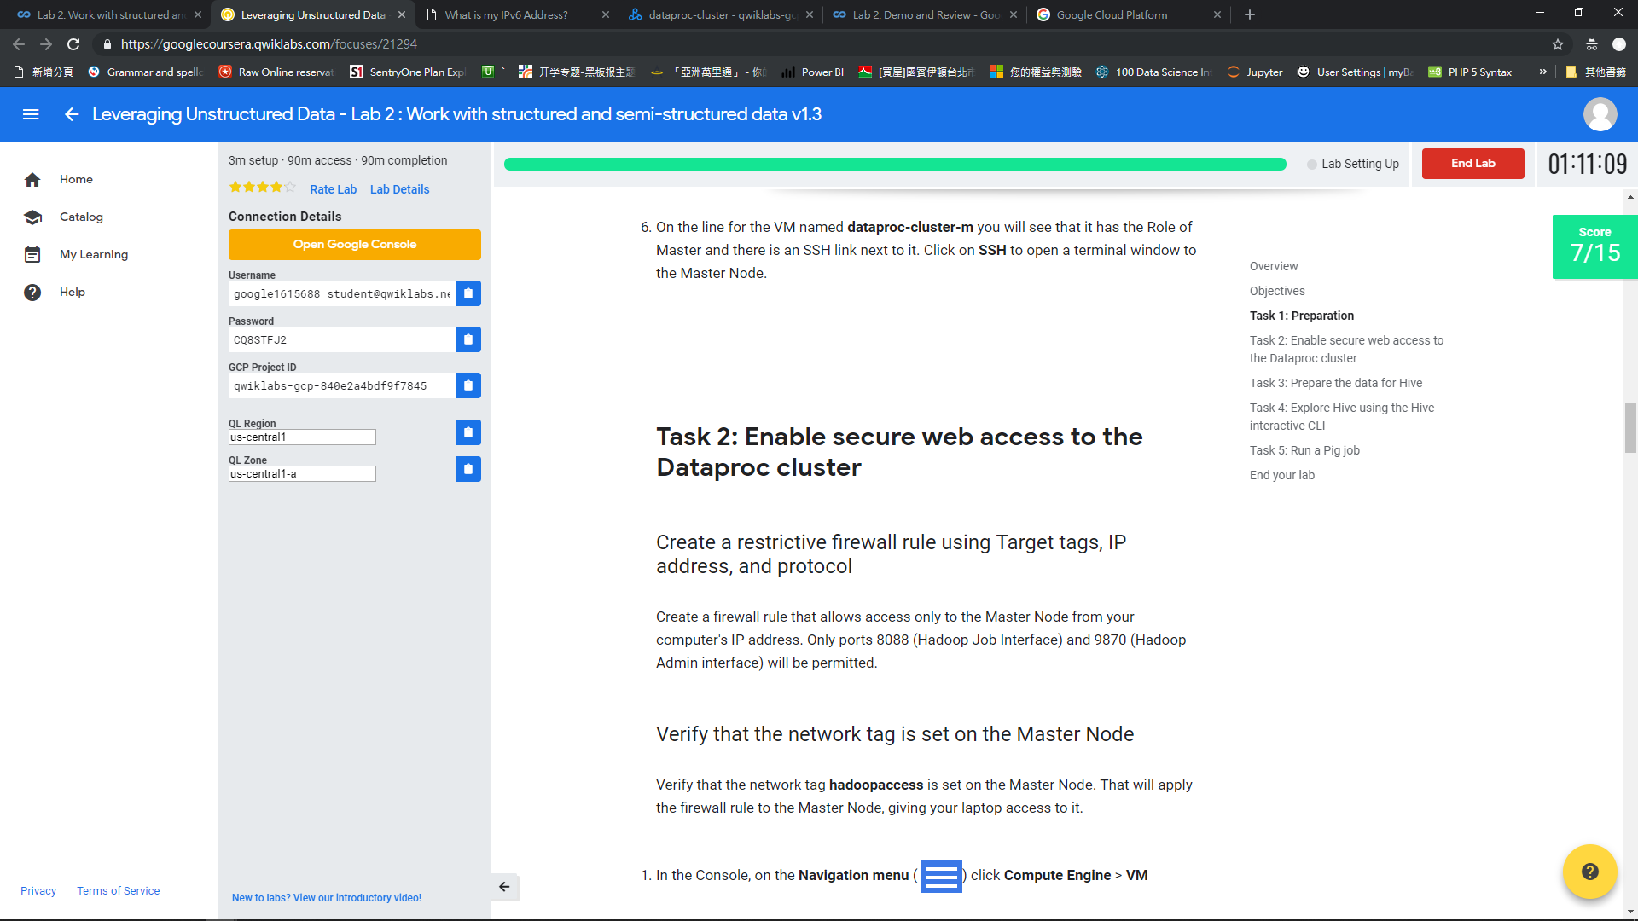

Slide 42
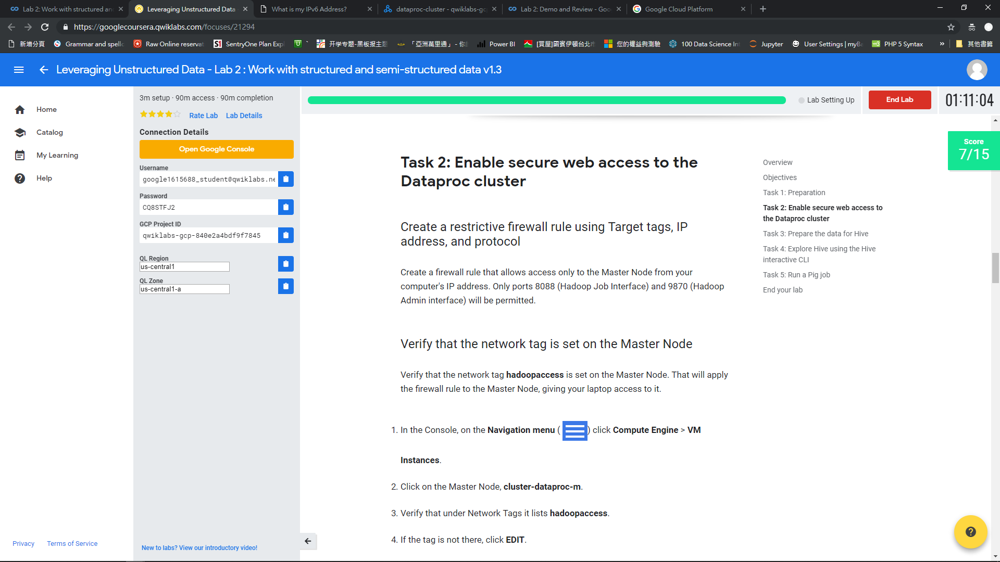

Slide 43
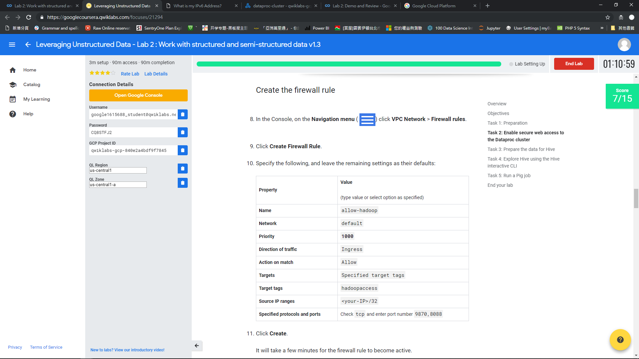

Slide 44
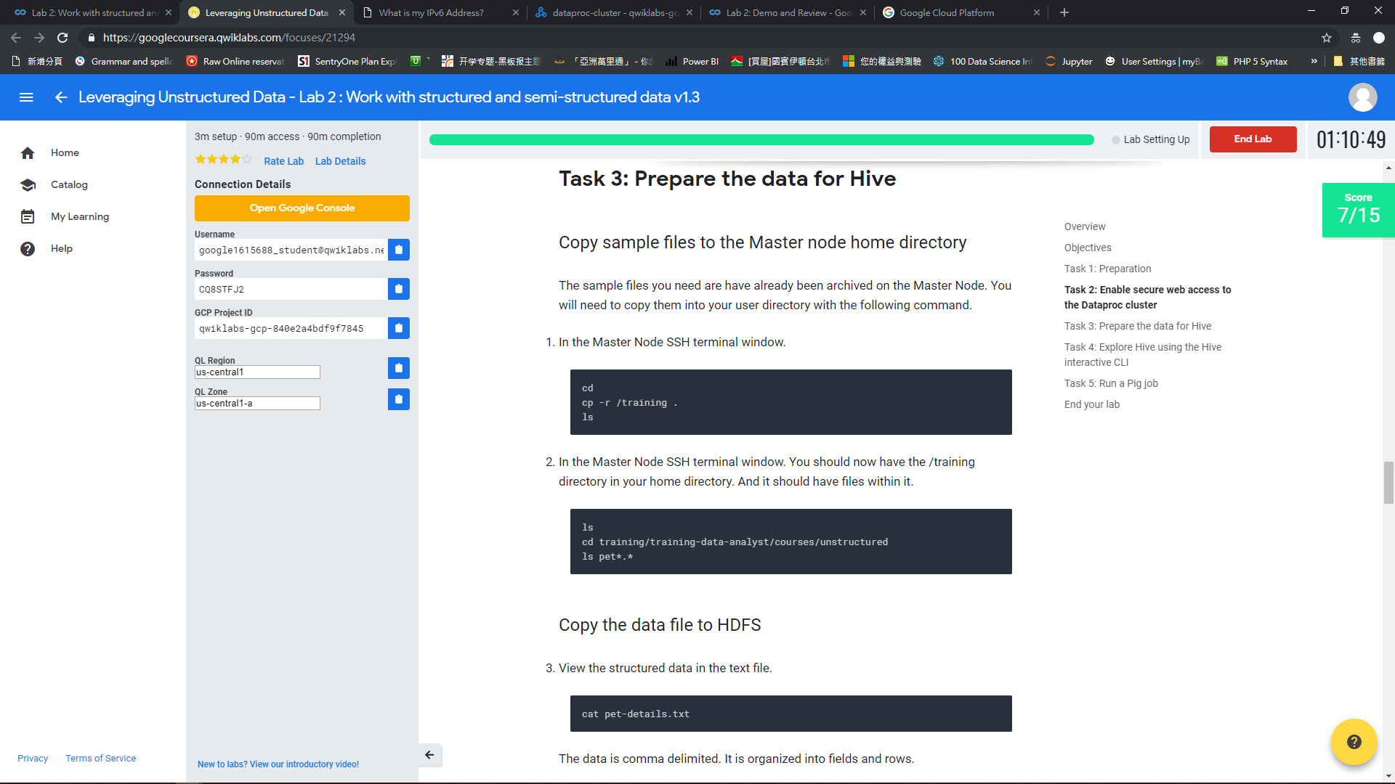

Slide 45
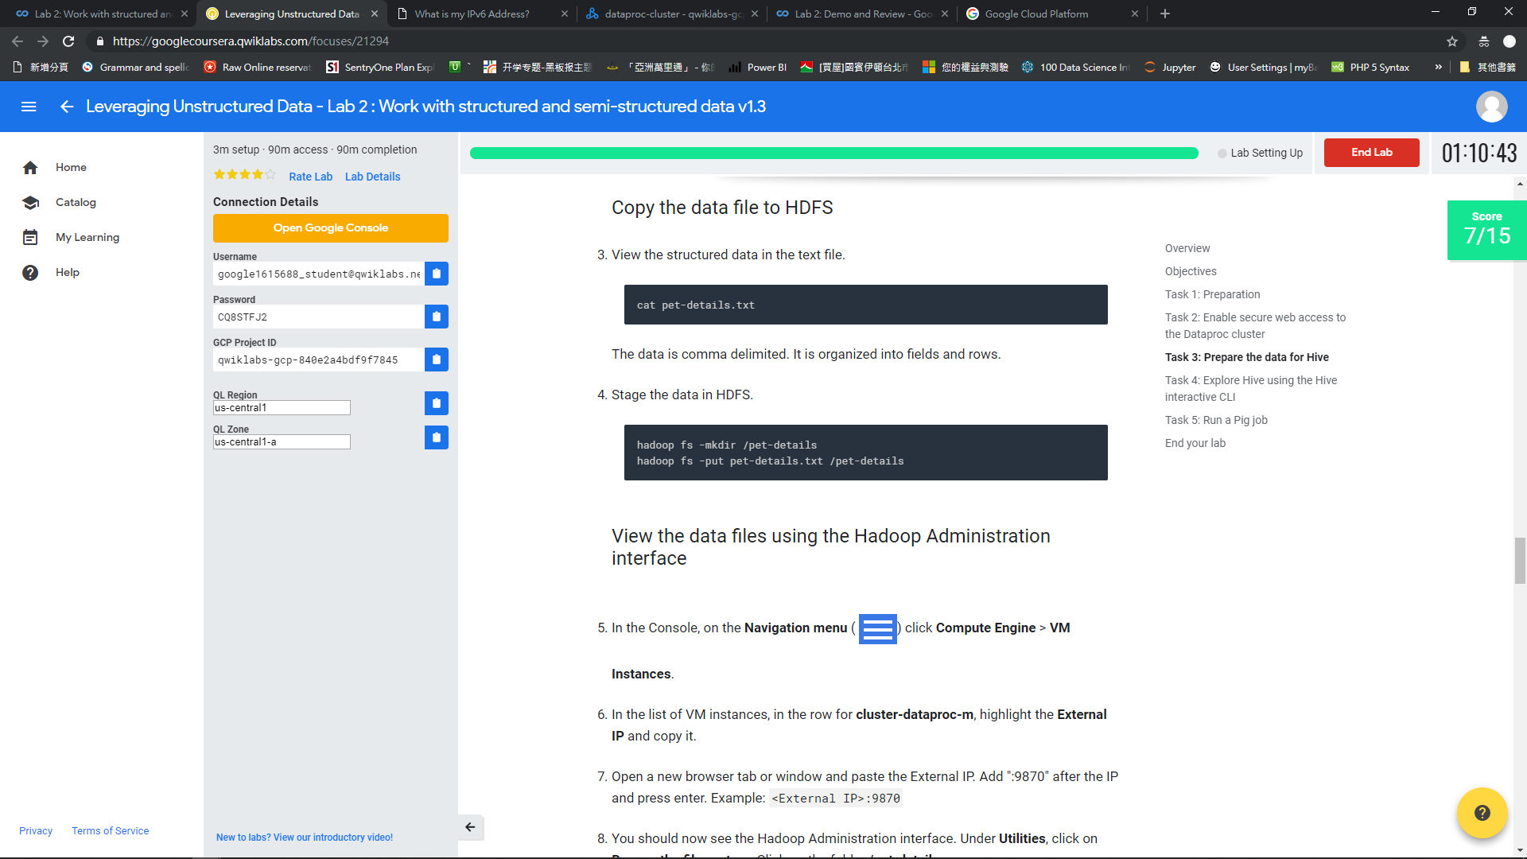

Slide 46
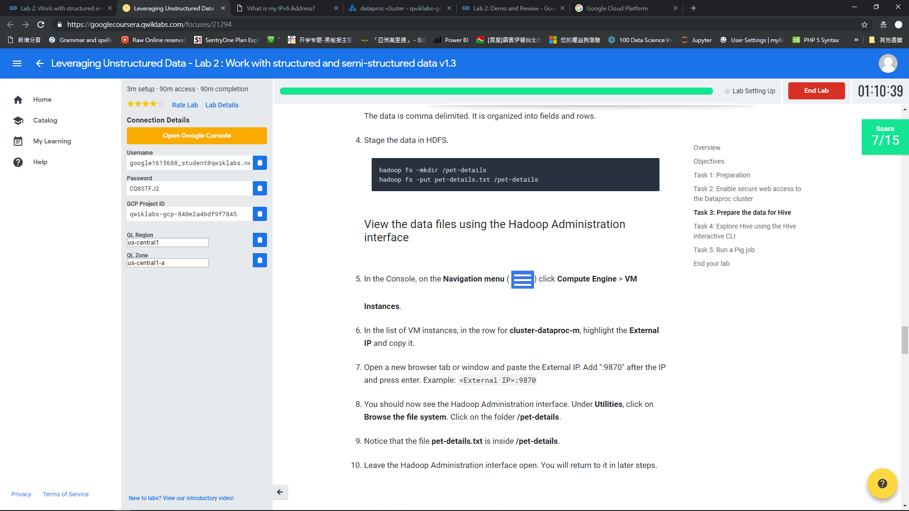

Slide 47
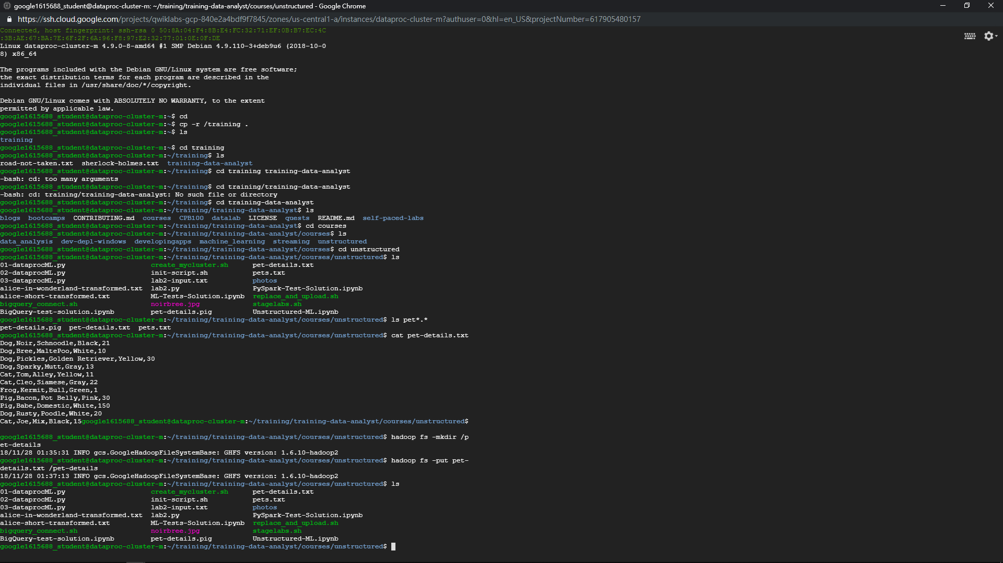

Slide 48
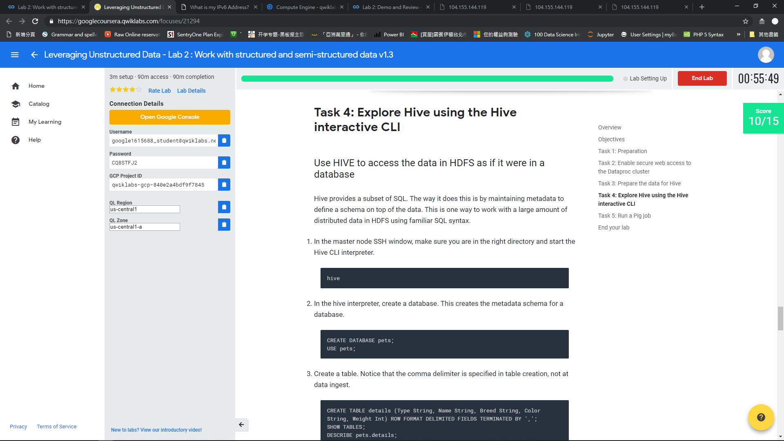

Slide 49
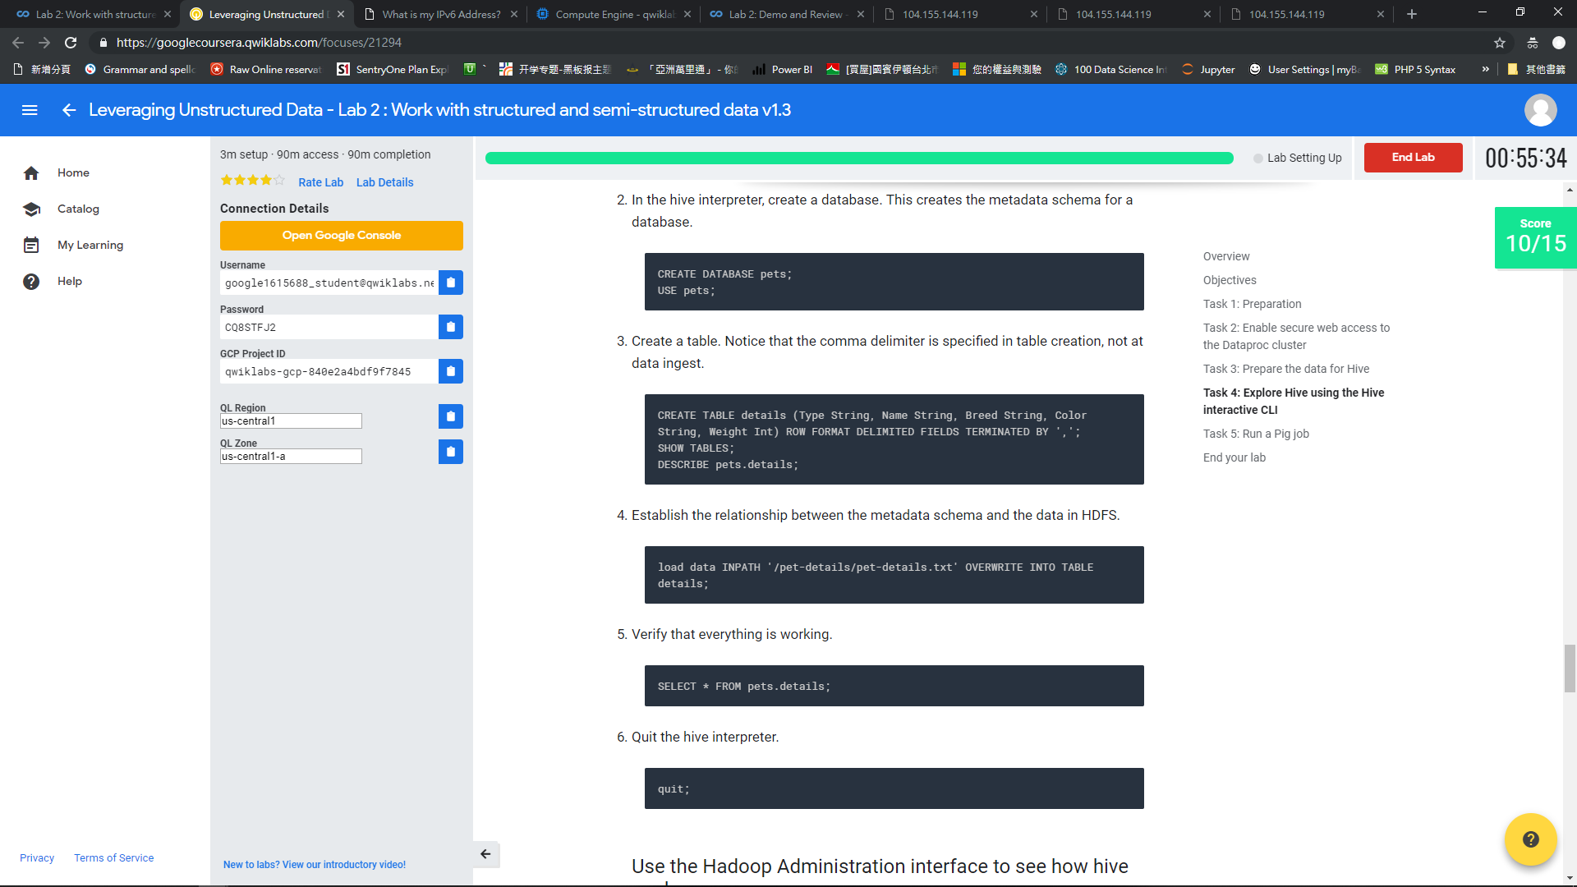

Slide 50
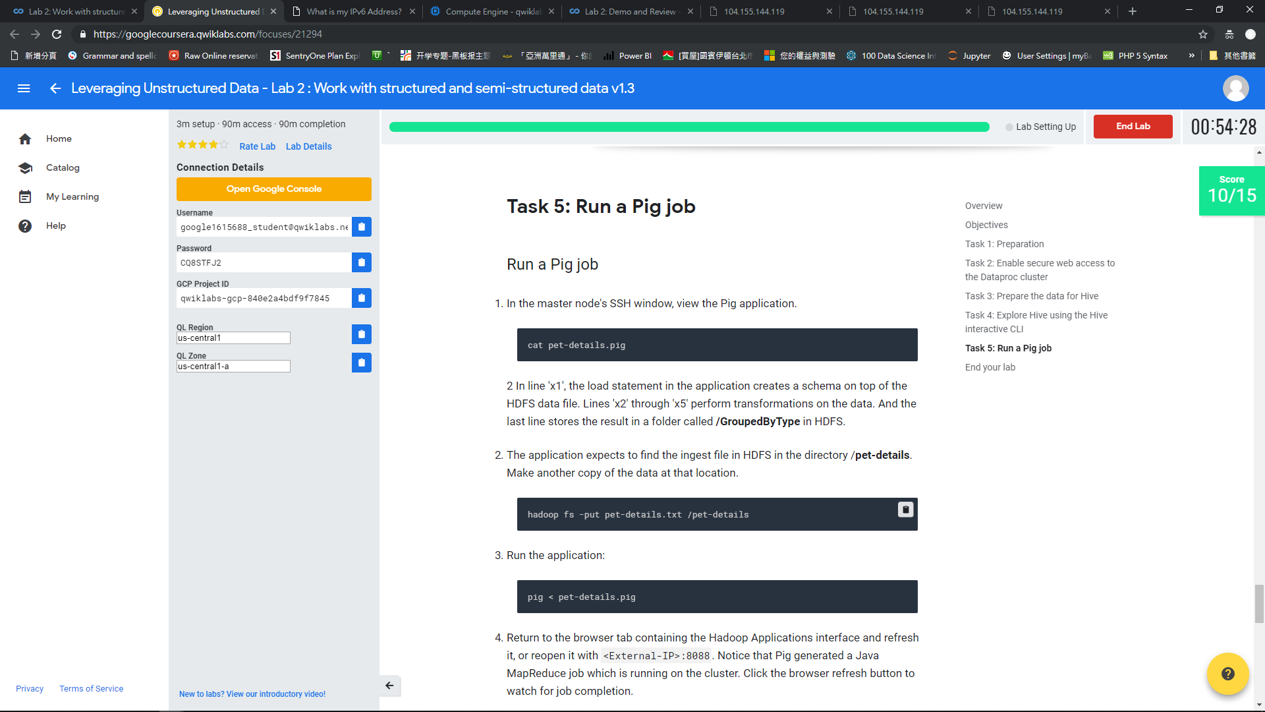

Slide 51
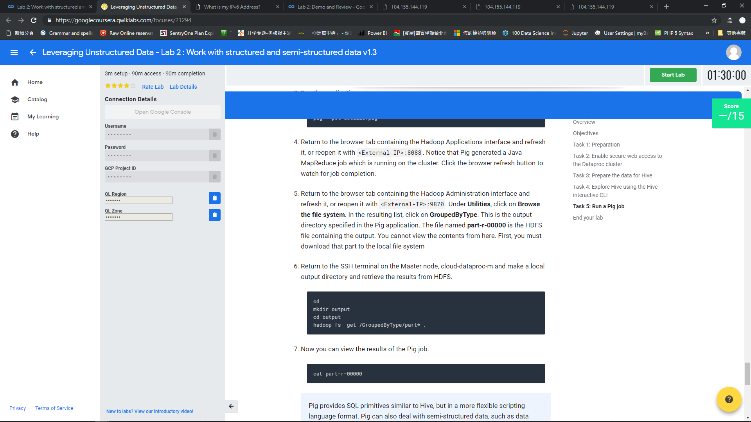

Slide 52
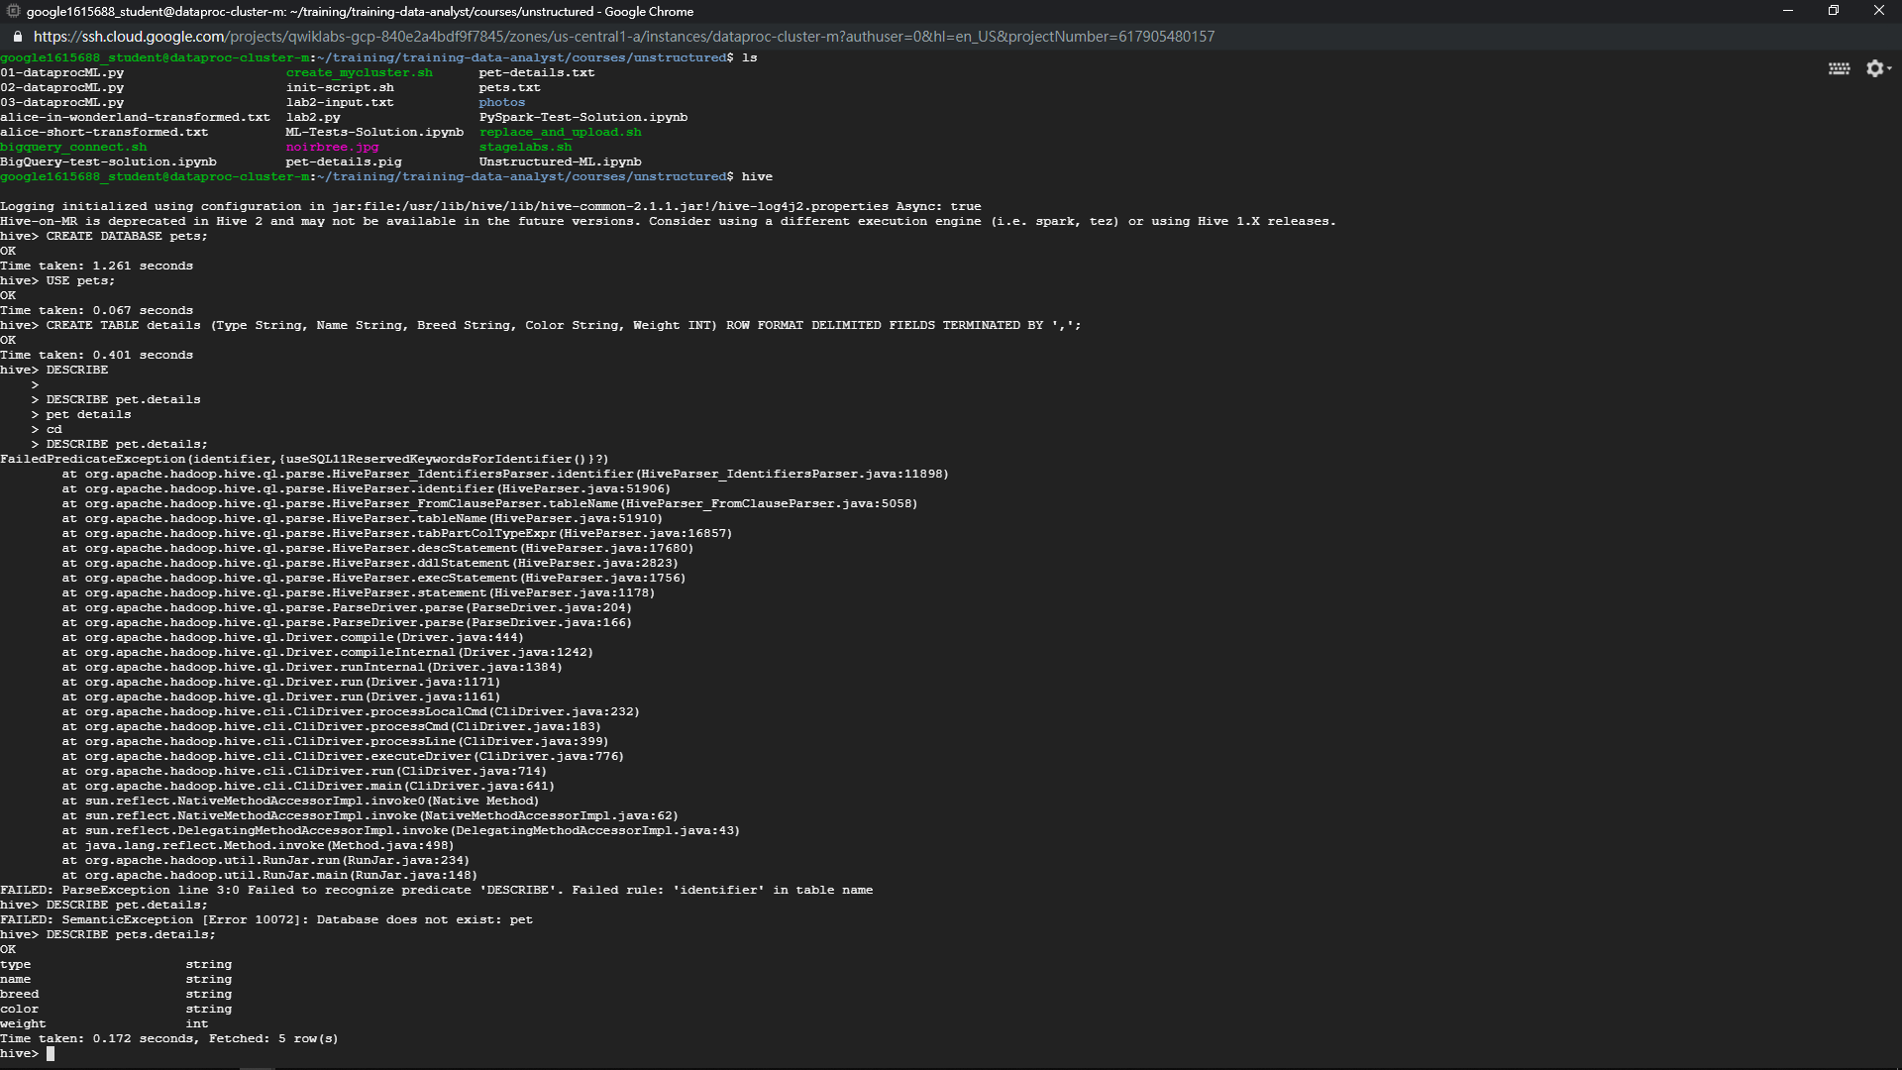

Slide 53
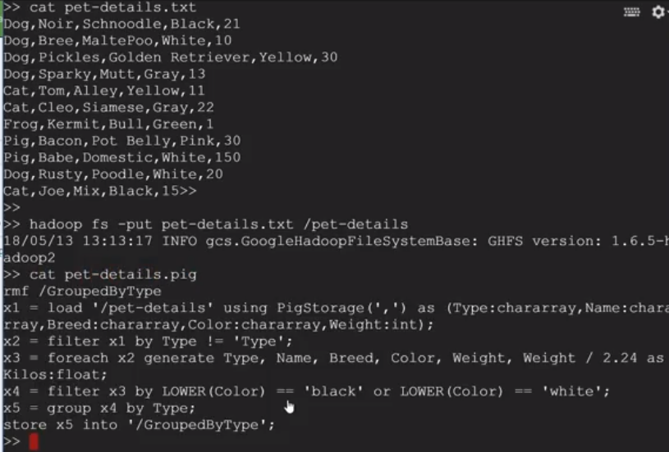

Slide 54
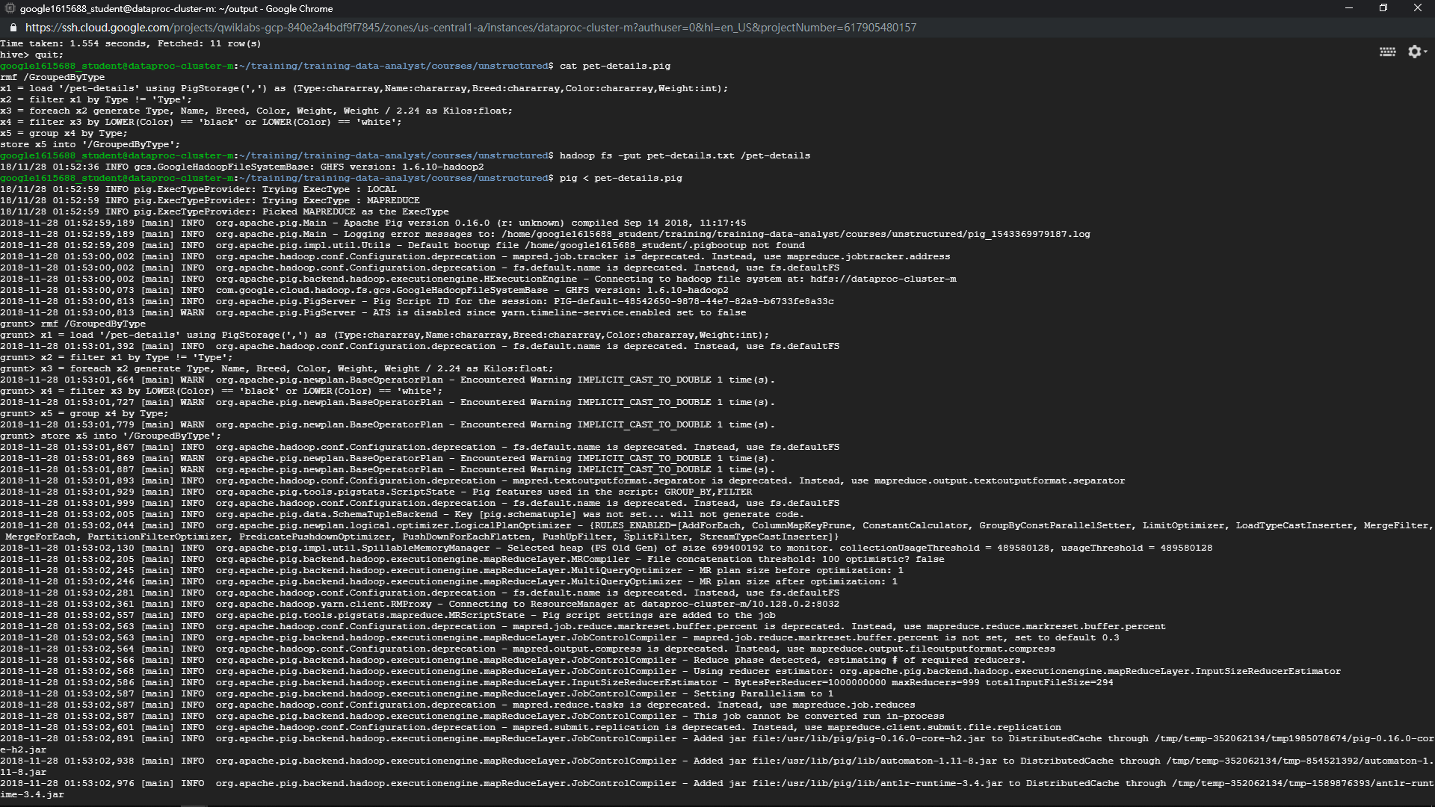

Slide 55
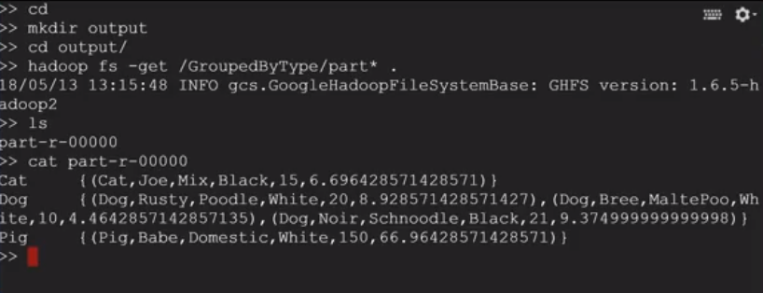

Slide 57
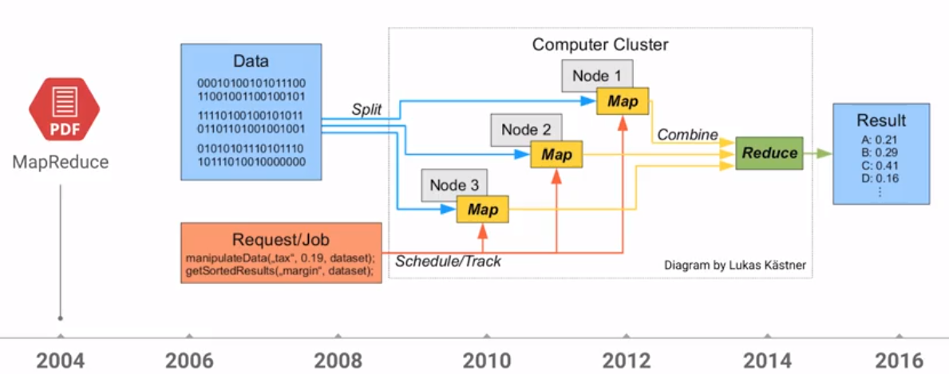
Separation of storage and compute
Google Cloud Command
Cloud change the assumption of big data
In the beginning storage and compute engine/resource are isolated. Bring data to Compute
Slow, Expensive(in terms of hardware), Cant scale
Horizontal scaling, distributed processing → separate data into small node, MapReduce

Slide 58

Separation of storage and compute
Innovation of Data Processing
HDFS: monitoring the health of the nodes, and recovering the data when a node is lost
HDFS = 3*data storage
Self healing system which allow pre-sharded of the cluster
Node is constantly being loosed or replaced
Manage resource is needed for load-balancing
to rescue performance
Consulting ：Buy more server or storage
YARN

Slide 59

Innovation of Data Processing
BigQuery
Cloud Storage

Slide 60

Innovation of Data Processing
Serverless Service

Slide 61

Data Processing
Innovation of Data Processing

Slide 62
Innovation of Data Processing
Pub/Sub is a messaging service that decouples senders and receivers, enabling asynchronous messaging for ingesting data.
This is useful for ingesting streaming data.
Publishers publish messages to a topic Subscribers subscribe to the topic and receive the messages

Slide 63

Innovation of Data Processing
Dataflow is a service that provides a unified method for both batch and streaming data processing.
Data flow builds on the Apache Beam SDK
We use Java or Python to construct a data processing pipeline
that runs on a serverless platform

Slide 64

Innovation of Data Processing
BigQuery is a data warehouse service
with a highly scalable interactive data exploration interface.
It can capture and analyze data in real time.

Slide 65

Pros to Serverless Service
Innovation of Data Processing

Slide 66

Pros to Serverless Service
Innovation of Data Processing
data storage compute engine

Slide 67

Pros to Serverless Service
Innovation of Data Processing
data storage compute engine
Hbase API

Slide 68

Pros to Serverless Service
Innovation of Data Processing
Hbase API

Slide 69

Dataproc software architecture
Spark

Slide 70

Dataproc Implementation Steps
Spark

Slide 71

Dataproc Implementation Steps
Spark

Slide 72

Spark Overview
Spark
Run batch jobs and streaming jobs, using in-memory processing for fast result

Slide 73

Spark Overview
Spark
Store requests at DAG. After examining all the request and deciding how to assign resource to each node, the requests will be separated to different pipeline and executed.

Slide 74


Slide 75


Slide 76


Slide 77
HIVE
SQL
Tell SQL exactly how to do
Pig
Handle Resource
Bridge the SQL and pipeline
Spark
Batch Processing
Steaming Processing
Pipelines
Makes EXEC plans

Slide 78


Slide 79


Slide 80


Slide 81


